Slide 1
RECENT AMENDMENTS RELATING TO CHARITABLE TRUSTS
By
CA Sudhir Baheti

Slide 2
Introduction
All the existing charitable and religious institutions are registered/approved under the following sections:
Section 10(23C)
Section 12A (prior to 1996)
Section 12AA (registered after 1996)
Section 12AB (registered after 2021)
Section 80G

Slide 3
Important Aspects at the Time of creating a New Charitable Trust
Intention of the Settlor/ Trustee/ Managing Committee Member/ Directors
Charitable Trust is not a tool for tax planning.
Constitution of the Charitable Trust is the most important document.

Slide 4
SECTION 10(23C) OF THE INCOME TAX ACT, 1961

Slide 5
Amendment in Sec 10(23C)(iiiad)
The entire income of the Education institute/ University shall be exempt:
Before Amendment
Any Education Institute/ University
Solely for education purpose and not for profit
Gross receipt of such institution does not exceed Rs. 1 Crore. **
After Amendment
Any Education Institute/ University
Solely for education purpose and not for profit
Gross receipt of such institution does not exceed Rs. 5 Crore.
** Where there are more than one such institutions, which are under a particular society or trust, the aggregate annual receipts of each of the educational institutions shall be considered separately and not together for claiming the exemption under this clause.

Slide 6
Situation | When the application has to be made? | The period for which the approval is applicable and receipt of final order
(i) Existing 10(23C) approved Trusts | Within 3 months from 01.04.2021 | Pass an Order for 5 years Final Order received within 3 months from the end of the month in which application is made.
(ii)Trusts already approved under new provisions of 10(23C) | Atleast 6 months prior to the expiry of the period for which approval was originally granted. | Pass an Order for 5 years (After meeting Terms & Conditions specified later) Final Order received within 6 months from the end of the month in which application is made.

Slide 7
Situation | When the application has to be made? | The period for which the approval is applicable and receipt of final order
(iii)New Trusts provisionally approved under 10(23C) | Atleast 6 months prior to the expiry of the provisional period for which approval was originally granted or within 6 months of commencement of its activities, whichever is earlier. | Pass an Order for 5 years (After meeting Terms & Conditions specified later) Final Order received within 6 months from the end of the month in which application is made or 6 months of commencement of its activities, whichever is earlier.
(iv) In any other case (Includes New Approvals and pending approvals under the old provisons for final order ) | One month PRIOR to the commencement of the P.Y. (relevant to the A.Y.) from which such said approval is sought | Pass an Order provisionally approved for 3 years from the A.Y. from which the approval is sought Final Order received within 1 month from the end of the month in which application is made.

Slide 8
New Explanation inserted for Corpus Donation u/s. 10(23C)
For Charitable Trust availing 10(23C) exemption, Total income includes Corpus Donation. As per the new explanation Corpus Donation will henceforth not included in the Total Income.
Now this clause is akin to section 12A/12AA.
This was not there in the Finance Bill 2020, but has been inserted in the Finance Act, 2020.

Slide 9
Amendment in Explanation 2 of section 11(1)
Before Amendment:
Any amount paid out of 15% or amount accumulated as per Explanation 1 read with section 11(1) to a trust/ institution registered under section 12AA with specific direction forming part of corpus will not be treated as application of income.
After Amendment:
Any amount paid out of 15% or amount accumulated as per Explanation 1 read with section 11(1) to any fund or trust or institution or any university or other educational institution or any hospital or other medical institution referred to in sub-clause (iv) or sub-clause (v) or sub-clause (vi) or sub-clause (via) of clause(23C) of section 10 or other trust or institution registered under section 12AA, being contribution with a specific direction that it shall form part of the corpus will not be treated as application of income.

Slide 10
Amendment in Sec. 11
Sec. 11(1)(d): Earlier Voluntary Contribution received with specific directions forming part of Corpus Fund were exempt without any condition, now a condition has been introduced that such fund should be invested/ deposited in the modes specified u/s 11(5) specifically for such Corpus. (w.e.f. 01/04/2022).
Explanation 4 has been inserted in Sec. 11: Application from the Corpus referred to in sec 11(1)(d), shall not be traded application of Income for Charitable and Religious purpose.
Explanation 5 has been inserted in Sec. 11: Application from any Loan or Borrowing shall not be treated as application of income in the year in which such application was made, but will be treated as application in the year of repayment of such Loan or Borrowing (to the extend of repayment).

Slide 11
New Provisions u/s. 12AB of the Income Tax Act, 1961

Slide 12
New Scheme for Registration u/s.
12AB
Application to be made by Trust (including the existing registered Trusts) in prescribed form and manner within specified time to PCIT/CIT.
The PCIT/CIT will pass order by granting a Unique Registration Number (URN).
The reasons behind introduction of this new Scheme are:
a. To provide electronic database.
b. Old Trust registered however misplaced their registration number nor the Income Tax Department has any record of the same.
c. New Trusts facing difficulties due to non- commencement of any activities.

Slide 13
Situation
When Application has to be made? -Section 12A(1)(ac) [newly added]
The period for which the registration is
applicable and receipt of final order
(i) Trusts Registered 12AA or 12A
already under
Within 3 months from
Pass an Order for 5 years
Final Order received within 3 months from the end of the month in which application is made.
Pass an Order for 5 years
(After meeting Terms & Conditions specified later)
Final Order received within 6 months from the end of the month in which application is made.
1.04.2021
(ii)Trusts registered 12AB
already
under
Atleast 6 months prior to the expiry of the period for which registration was originally granted.
(iii)New provisionally registered 12AB
Trusts
Atleast 6 months prior to the expiry of the provisional
a. Pass an Order for 5 years
(After meeting Terms & Conditions
under
period registration
for which was originally
specified later)
b. Final Order received within 6 months from the end of the month in which
granted or within 6 months
of commencement
of its application
is
is made or
of
6 months of
its
activities, earlier.
whichever
commencement
activities,
whichever is earlier.

Slide 14
Situation
When Application has to be made? -Section 12A(1)(ac) [newly added]
The period for which the registration is
applicable and receipt of final order
(iv) Trusts becoming
registration inoperative
Atleast 6 months prior to the commencement of the
A.Y. for which registration is
sought
a. Pass an Order for 5 years
(After meeting Terms & Conditions
specified later)
b. Final Order received within 6 months from the end of the month in which application is made.
due to first proviso of
section 11(7). (12A or 12AA)
(v) Trust adopted
or
Within 30 days from the
a. Pass an Order for 5 years
undertaken modifications
date of said adoption or (After meeting Terms & Conditions of its modification.
which do not
to the
of
specified later)
b. Final Order received within 6 months from the end of the month in which application is made.
objects conform
conditions
registration
(vi) In any (Includes Registrations
other
case One month PRIOR to the New commencement of the P.Y. and (relevant to the A.Y.) from which such said
registration is sought
Pass an Order provisionally registering for 3 years from the A.Y. from which the registration is sought
Final Order received within 1 month from the end of the month in which application is made.
pending registrations
under old provision of 12AA for final order )
24th April 2020
JKKG
12

Slide 15
Simultaneous Benefits under two sections will not be allowed
If a Trust is registered u/s. 12A(1) or 12AA and either u/s. 10(23C) and makes an application either u/s. 10(23C) then the registration u/s. 12AB will not be operative and vice versa if a Trust makes an application u/s. 12AB then the approval u/s. 10(23C) will be inoperative.
In short henceforth the Trust will be able to enjoy exemptions either u/s. 10(23C) or u/s. 12AB.
The word used is “inoperative”.

Slide 16
Forms for filing Application for Registration u/s 12AB
Form 10A
Trust/ Institution already registered u/s 12A/12AA before 01/04/2021.
Fresh registration u/s 12AB.
Form 10AB
Trust already registered u/s 12AB & registration due to expire.
Trust is provisionally registered u/s 12AB.
Trust became inoperative due to first proviso to sec 11(7).
Modification in the object of the Trust.

Slide 17
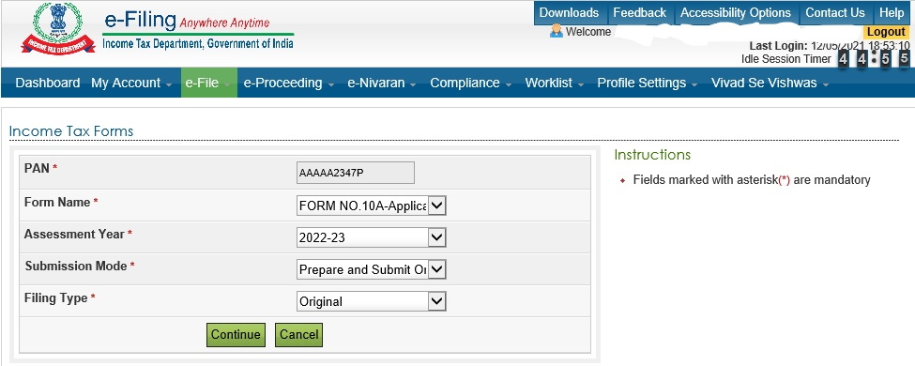
How to file Form 10A
Form 10A shall be filed online on the Income Tax Portal

Slide 18
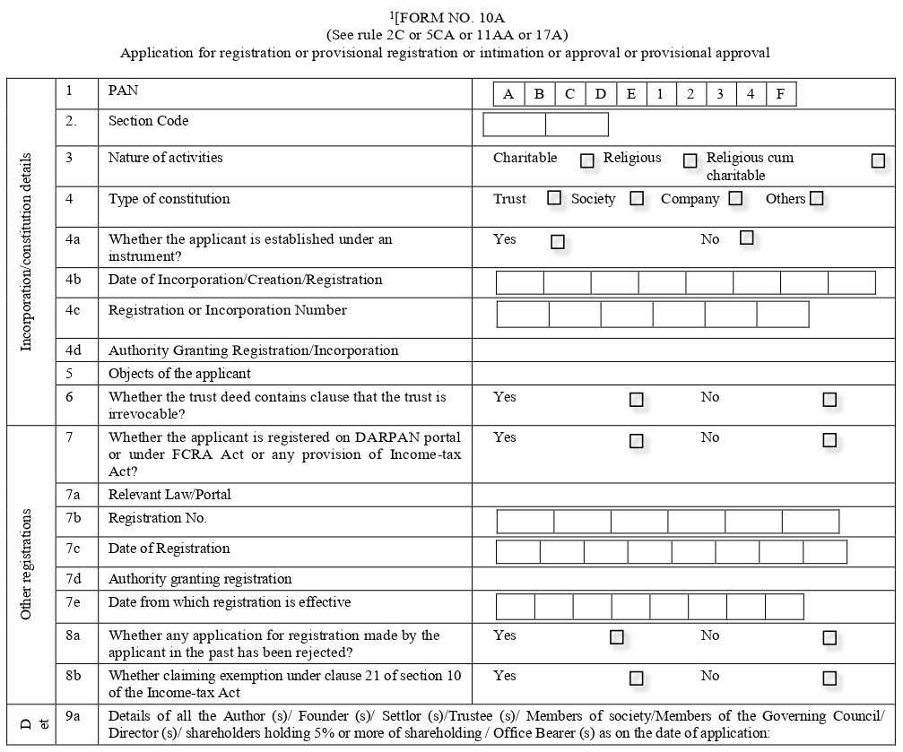

Slide 19
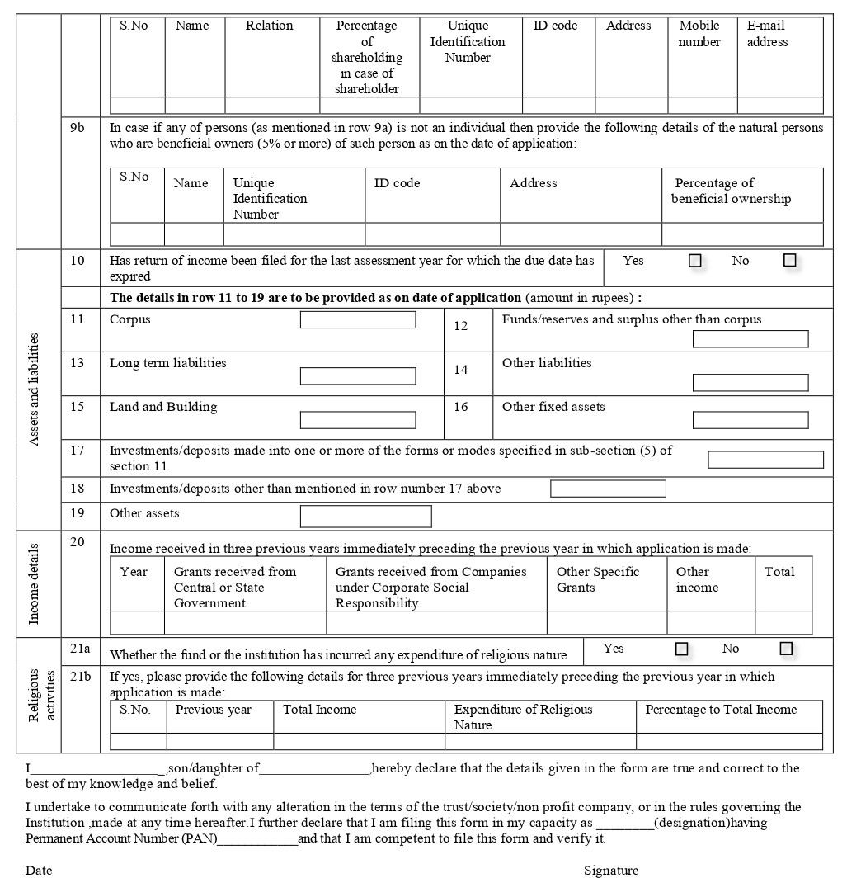

Slide 20
Manner of furnishing Form 10A
The form 10A shall be verified electronically:
Under digital signature, if the return of income is required to be furnished under digital signature
Through electronic verification code in case not covered above.

Slide 21
Information required for filing Form 10A
Constitution of the Applicant: Trust/ Society/ Company/ Other.
Nature of the Activities: Charitable/ Religious/ Religious cum Charitable.
Object of the Applicant: as per the Trust Deed/ Memorandum of the applicant.
Details of Registration under 12A of the Act, FCRA Registration, Darpan (Niti Ayog registration)
Details of all Trustees/ Members (including Name, PAN/ Aadhar/ Voter id etc, Mobile No & Email id)
If the Return of Income for the last AY is not filed: details of the Balance Sheet as on date & details of the Income earned during the three preceding FY.
If the Return of Income for the last AY is not filed and the Trust is religious trust amount of expenditure in the religious activities.

Slide 22
Documents to be accompanied with Form 10A
Applicant is created/ established under an instrument, copy of such instrument. (Trust Deed)
Applicant is created/ established otherwise than an instrument, copy of document evidencing the creation/ establishment. (Notification/ Circular of the Government)
Registration with Registrar of Companies/ Firms & Societies/ Public Trust.
Registration Certificate under FCRA.
Registration Certificate under 12A/ 12AA
Rejection of grant of registration u/s 12A/12AA (if any)
If the applicant is in existence, the annual accounts of the applicant relating to maximum three preceding FY.
Continued….

Slide 23
Documents to be accompanied with Form 10A
All the documents should be self certified by the authorized person of the applicant.
All the documents should be scanned in PDF format only and not scanned below the 300dpi.
The size of all the documents together should be less than 50MB.
If the documents are in vernacular language, self certified translation of the same is required to be uploaded.

Slide 24
AMENDMENT IN SECTION 80G OF THE INCOME TAX ACT, 1961

Slide 25
Situation |  | When the application has to be made? |  |  | The period for which the approval is applicable and receipt of final order
(i) Existing approved Trusts | 80G | Within 3 1.04.2021 | months | from | Pass an Order for 5 years Final Order received within 3 months from the end of the month in which application is made.
(ii)New Trusts already approved under 80G |  | Atleast 6 months prior to the expiry of the period for which approval was originally granted. |  |  | Pass an Order for 5 years (After meeting Terms & Conditions specified later) Final Order received within 6 months from the end of the month in which application is made.

Slide 26
Situation | When the application has to be made? | The period for which the approval is applicable and receipt of final order
(iii) New Trusts provisionally approved under 80G | Atleast 6 months prior to the expiry of the provisional period for which approval was originally granted or within 6 months of commencement of its activities, whichever is earlier. | Pass an Order for 5 years (After meeting Terms & Conditions specified later) Final Order received within 6 months from the end of the month in which application is made or 6 months of commencement of its activities, whichever is earlier.
(iv) In any other case (Includes New Approvals and pending approvals of old 80G for final order ) | One month PRIOR to the commencement of the P.Y. (relevant to the A.Y.) from which such said approval is sought | a. Pass an Order provisionally approved for 3 years from the A.Y. from which the approval is sought b. Final Order received within 1 month from the end of the month in which application is made.

Slide 27
Circular issued for availing deduction under section 80G
The date for making various donation for claiming deduction under section 80G has been extended to 30th June, 2020. Hence the donation can be made up to 30.06.2020 for claiming the deduction for FY 2019-20.
This clearly shows that the donor can claim exemption under section 80G in F.Y. 2019-20 even if the donation is given upto 30.06.20
Important point is that the Trust will treat this as income in the year in which it is received.

Slide 28
Annual Statement of Donation (80G)
The Trust or institution (donee) who have 80G registration have to submit a Annual Statement of Donation (ASD) in form 10 BD for such period as may be prescribed and delivered or cause to be delivered to the prescribed Income Tax Authority or the person authorized by such authority within such time as maybe prescribed.
If the ASD contains any mistakes or there is a need for any addition/deletion/updation of information in the same then a correction statement maybe delivered in the prescribed form and verified in prescribed manner.
The information in the ASD should generally contain the donor details such as the Name, Address, PAN Number, Aadhar Number and Amount donated.
Donors will get deduction only based on ASD filed by the Trust. It is akin to 26AS TDS Credit.

Slide 29
Annual Statement of Donation (80G) contd…..
The charitable institution shall furnish to the donor, a certificate in form 10 BE which shall specify the amount of donation in a prescribed manner containing prescribed particulars and within prescribed time.
The donor shall be provided the deduction under 80G directly in the return of income on the basis of the prescribed statements (ASD).
Incase there is a delay in filing ASD, a late fee of Rs. 200/- per day shall be applicable u/s. 234G , which is mandatory. Fees to be paid before delivering the ASD or before furnishing the certificate.
A penalty of Rs. 10,000/- which may go up to Rs. 10,00,000/- u/s. 271K.

Slide 30
Other Terms and Conditions applicable to approval u/s. 10(23C), registration u/s. 12AB and approval u/s. 80G
Call for such documents or information or make such inquiries as the Officer thinks necessary in order to satisfy himself about,
- The genuineness of activities
-The compliance of such requirements of any other law for the time being in force as which are material for the purpose of achieving its objects.

Slide 31
OTHER MISCELLANEOUS AMENDMENTS RELATED TO CHARITABLE TRUSTS

Slide 32
Amendments under Section 80GGA
The Finance Bill, 2020 has specified that no deduction shall be allowed to the donor under Section 80GGA in respect, of donation exceeding amount of Rs. 2,000/- unless donation is paid in any mode other then cash.

Slide 33
Amendment under Section 115TD
After the introduction of Section 12AB, nothing contained in Section 12AA shall be applicable to the trust or institution registered under Section 12AA. Hence in order to make the provisions of Section 115TD applicable, the Finance Bill, 2020 have substituted the word, figures and letters “under section 12AA” with the words, figures and letters “under section 12AA or section 12AB” in Section 115TD which shall be effective from 1st June, 2020.

Slide 34
Date of Filing Audit Report in Form 10B or Form 10BB and ITR
The date of filing the Form 10B or Form 10BB for AY 2021-22 will be on or before 30th September, 2021.
The date of filing the ITR for AY 2021-22 will be on or before 31st October, 2021

Slide 35
Proposed Provision under Maharashtra Public Trust Act, 1950
The Maharashtra Public Trust Act, 1950 (MPT) is proposed to be amended to include new fund.
Currently u/s. 57 of MPT there is a fund called “Public Trusts Administration Fund”. The Mumbai High Court as granted stay for collecting any contribution u/s.57.
Due to COVID-19 a new section 57A of MPT is proposed which will be called “Epidemic Disease Relief Fund & Disaster Relief Fund” by invoking provisions of the Epidemic Disease Act, 1987 or occurrence of any disaster under the Disaster Management Act, 2005.
There will be a contribution towards this new fund which will be a percentage of their Gross Annual Income as prescribed.

Slide 36
New Provision under FCRA
The Ministry of Home Affairs (MHA) has come out with an online response form in relation to COVID-19 activities.
It is not mandatory, but advisable to file Online response. Only applicable to Trust having FCRA registration.
This online form may be submitted by the 15th of every month. (monthly reporting)
The actual activities relating to COVID-19 needs to be submitted. Both FCRA and Local Funds, including activities in Kind need to be reported.
You need to login to fcraonline.nic.in and go to the header titled “Service under FCRA”.

Slide 37
Other Issues
A Charitable Trust having primarily Educational activities as its object can donate for COVID-19?
If a Charitable Trust which is into Educational activities only and is registered under FCRA, receives donation for Education purpose, can this donation received be utilized for COVID- 19 purpose. Let us assume that donor has no objection for the same.

Slide 38
Responsibility as an Auditor
Audit of
Proprietorship
Concern
Partnership
Concern & LLP
Private & Public
Limited Company
Charitable Trusts
& Institutions
Proprietorship
Concern
Responsibility towards the Proprietor
Responsibility towards the Partners
Responsibility towards the Shareholders
Responsibility towards the PUBLIC AT
LARGE and
Donor

Slide 39
Broad scheme of computation of income u/s 11
a. Gross receipts (excluding corpus donations)
b. Less: deductions
c. Income derived from property held under trust [s. 11 (1)(a)]. [a – b]
d. Less: i) application of income in India [s. 11(1)(a)]
ii) “deemed” application of income [s. 11(1)(a) r.w. Expl. (2) to s. 11(1)]
iii) “basic” accumulation up to 15% of income [s. 11(1)(a)]
iv) “secondary” accumulation for 5 years up to 85% [s. 11(2)]
v) application of capital gains [s. 11(1A)]
vi) anonymous donations (taxed separately under s. 115BBC @ 30%) [s. 13(7)]
e. Add: i) income chargeable under section 11(1B)
II) “deemed income” [s. 11(3)].
iii) business income not incidental to attainment of objects [s. 11(4A)]
iv) value of medical or educational services to interested parties [s. 12(2)]
v) income which is not derived from property held under trust.

Slide 40
CA. Sudhir Baheti
email : sudhir@rcnco.net
9422102270

