Slide 1


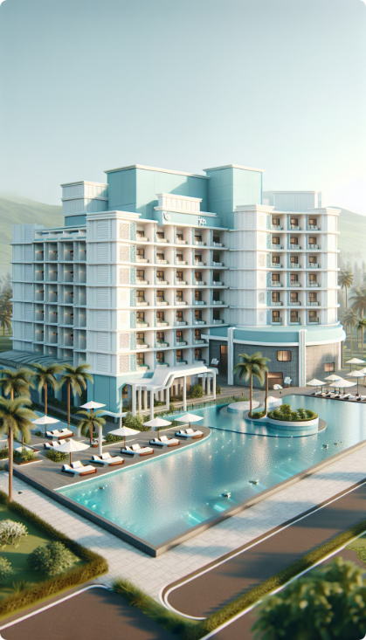
Tourism Policy of Maharashtra, 2024
The Tourism Policy of Maharashtra, 2024 is a comprehensive initiative aimed at boosting the tourism sector in the state. This policy introduces a range of incentives and provisions to encourage investment and development in various tourism projects.
Effective Date
1
The policy comes into effect on July 18, 2024.
2
Validity
It remains valid for 10 years or until amended.
Budget
3
INR 1,666 crore per year sanctioned for incentives.
CA Prakalp Sarda
www.hotelsubsidy.com

Slide 2





Transitional Provisions:
Eligibility Period Extension
The period of eligibility as per Tourism Policy 2016 shall be automatically extended as per the eligible duration, as approved for those projects.
Projects Under Tourism Policy 2016
Projects initiated under 'Tourism Policy 2016' but have not commenced commercial operations or have not received occupancy certificates, shall be treated under the 'Tourism Policy 2024'.
Eligible Enterprise for Capital Subsidy
New and expansion tourism units (including acquired tourism units) who obtained or applied for provisional Registration certificate under Tourism Policy 2024 will be eligible for capital incentives.
CA Prakalp Sarda
www.hotelsubsidy.com

Slide 3
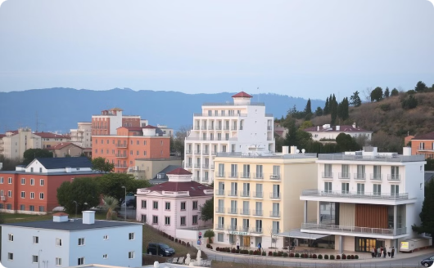


Eligible Tourism Units:
Accommodations (A)
Accommodations (B)
Food and Beverage
Hotels, Motels,
Service Apartments,
Wayside Amenities,
Youth Hostels/clubs,
Time Sharing Resort, Agro/Eco/Rural tourism units,
Restaurant/Food Kiosk,
Resorts/ Cottage/Log Huts.
Beach Shack etc.
Homestays, Tree House, Mud cottage
Cruise Boats/Yacht etc.
CA Prakalp Sarda
www.hotelsubsidy.com

Slide 4
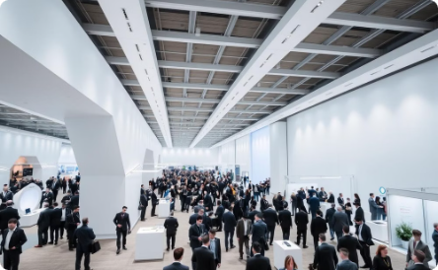
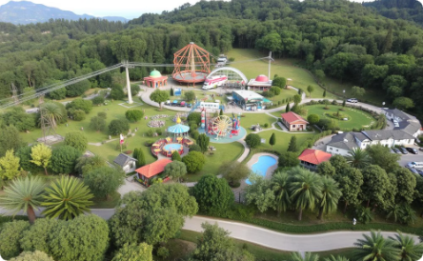
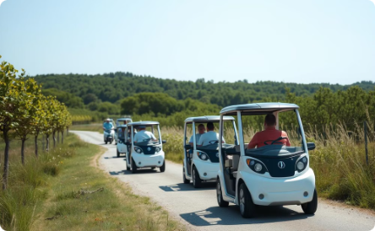
Eligible Tourism Units:
Travel, Tourism, and Entertainment
Entertainment and Recreation
Other Tourism Units
Handloom,
Convention centres,
Ropeways, Golf Course
Development of Hospitality Park,
Exhibition Space,
Amusement Parks,
Hotel Management Institute etc.
Wellness Centres
Caravan & Caravan Park, AR-VR Zones,
E-Vehicles for tourist ,etc.
7D and above Experience,
Theatres /shopping malls / Video Game Zones etc
CA Prakalp Sarda
www.hotelsubsidy.com

Slide 5
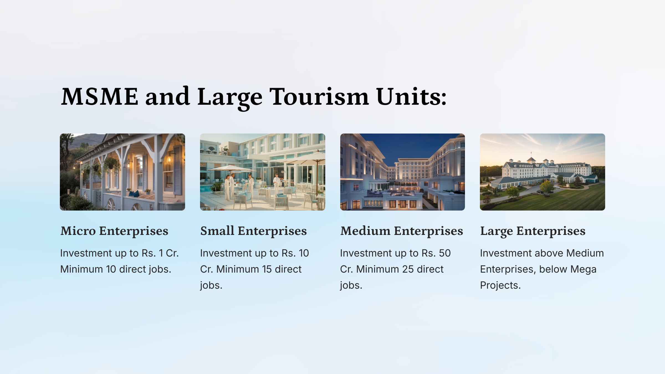
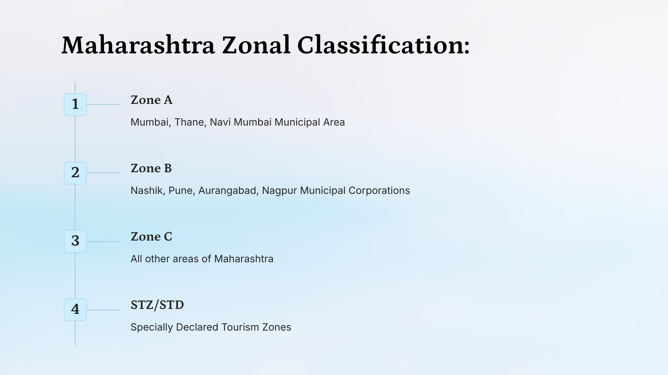



Classification of Project:
The policy offers capital incentives for all eligible tourism units, with varying percentages based on the category of the project. These incentives are designed to encourage investment in different types of tourism facilities across the state.
Accommodation Units
20% of ECI capped at INR 20 crores for Category A.
15% of ECI capped at INR 15 Crores for Category B.
Other Units
15% of ECI capped at INR 15 crores for Food & Beverages, Travel & Tourism, and Entertainment & Recreation.
15% of ECI capped at INR 10 crores for Other Tourism Units
Ultra Mega Projects
10% of ECI capped at INR 25 crores
#ECI - Eligible Capital Investment. *In five fixed annual installment
Additional Incentive of 5% for Women Entrepreneurs/SC/ST/Differently abled
www.hotelsubsidy.com

Slide 6
Classification of Project:
The policy offers capital incentives for all eligible tourism units, with varying percentages based on the category of the project. These incentives are designed to encourage investment in different types of tourism facilities across the state.
Accommodation Units
20% of ECI capped at INR 20 crores for Category A.
15% of ECI capped at INR 15 Crores for Category B.
Other Units
15% of ECI capped at INR 15 crores for Food & Beverages, Travel & Tourism, and Entertainment & Recreation.
15% of ECI capped at INR 10 crores for Other Tourism Units
Ultra Mega Projects
10% of ECI capped at INR 25 crores
#ECI - Eligible Capital Investment. *In five fixed annual installment
Additional Incentive of 5% for Women Entrepreneurs/SC/ST/Differently abled
www.hotelsubsidy.com

Slide 7
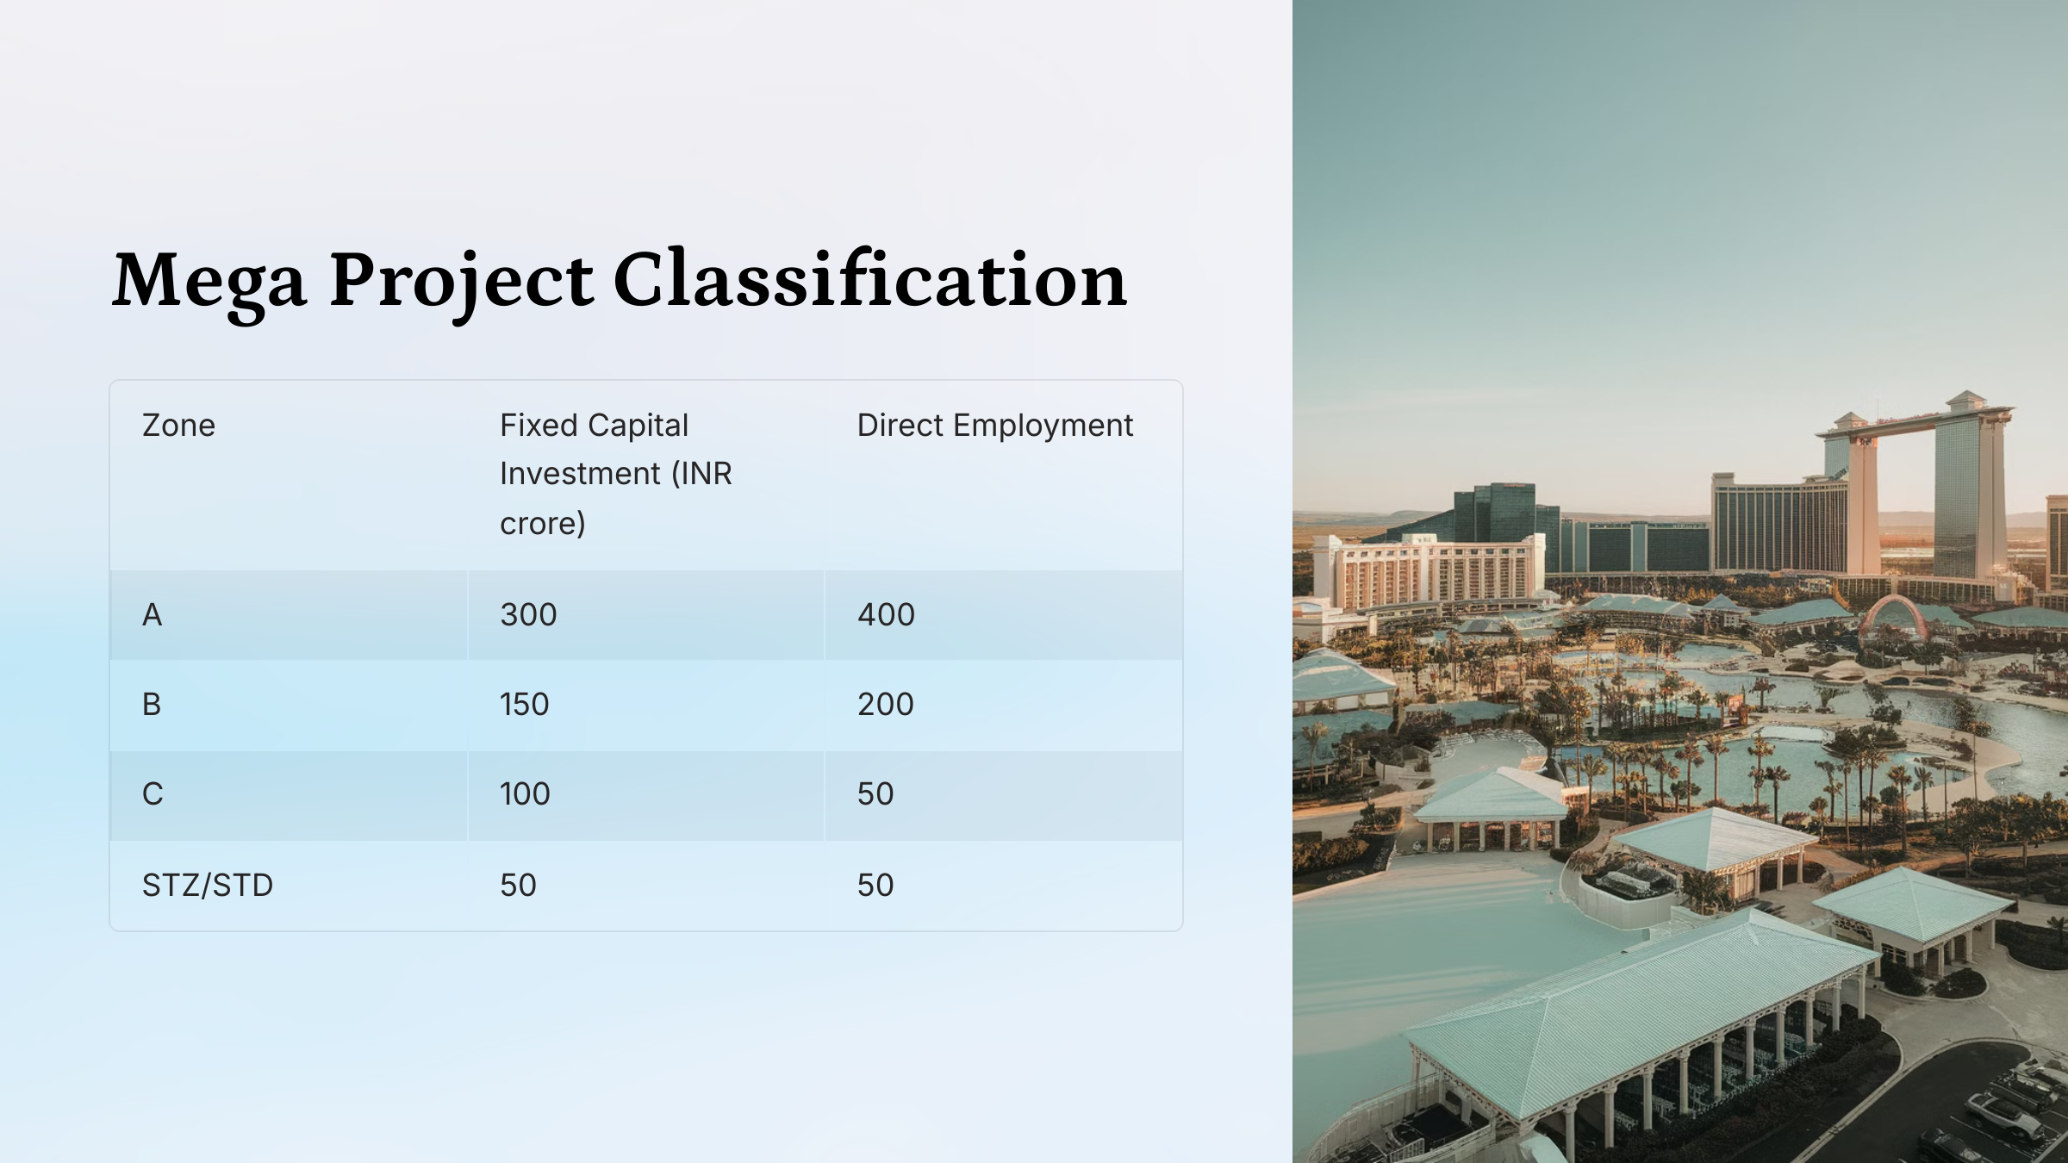
Classification of Project:
The policy offers capital incentives for all eligible tourism units, with varying percentages based on the category of the project. These incentives are designed to encourage investment in different types of tourism facilities across the state.
Accommodation Units
20% of ECI capped at INR 20 crores for Category A.
15% of ECI capped at INR 15 Crores for Category B.
Other Units
15% of ECI capped at INR 15 crores for Food & Beverages, Travel & Tourism, and Entertainment & Recreation.
15% of ECI capped at INR 10 crores for Other Tourism Units
Ultra Mega Projects
10% of ECI capped at INR 25 crores
#ECI - Eligible Capital Investment. *In five fixed annual installment
Additional Incentive of 5% for Women Entrepreneurs/SC/ST/Differently abled
www.hotelsubsidy.com

Slide 8
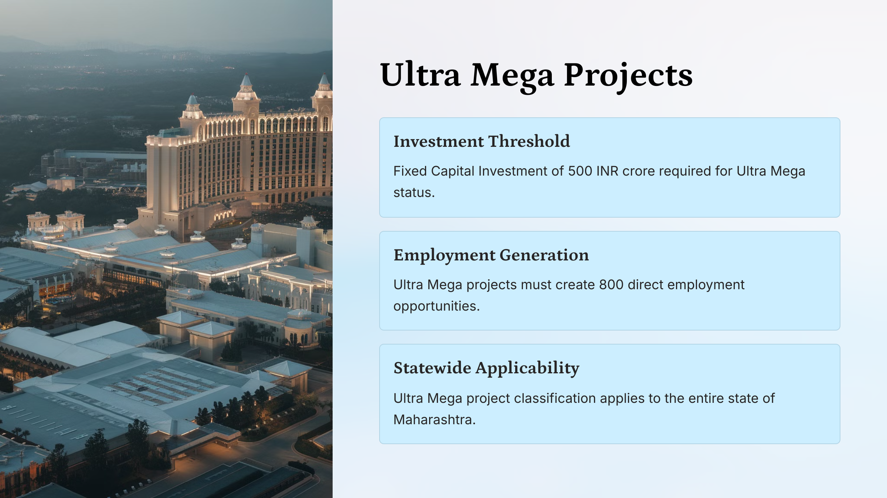
Classification of Project:
The policy offers capital incentives for all eligible tourism units, with varying percentages based on the category of the project. These incentives are designed to encourage investment in different types of tourism facilities across the state.
Accommodation Units
20% of ECI capped at INR 20 crores for Category A.
15% of ECI capped at INR 15 Crores for Category B.
Other Units
15% of ECI capped at INR 15 crores for Food & Beverages, Travel & Tourism, and Entertainment & Recreation.
15% of ECI capped at INR 10 crores for Other Tourism Units
Ultra Mega Projects
10% of ECI capped at INR 25 crores
#ECI - Eligible Capital Investment. *In five fixed annual installment
Additional Incentive of 5% for Women Entrepreneurs/SC/ST/Differently abled
www.hotelsubsidy.com

Slide 9
Eligibility Period for Incentive:
Type of Unit/ Zone
A
B
C, STZ/STD
Ultra Mega Project
Large/ Mega/ Ultra Mega Projects
5 years
7 years
10 years
15 years
MSME Projects
5 years
5 years
7 years
-
Other Tourism Projects
3 years
3 years
5 years
-
CA Prakalp Sarda
www.hotelsubsidy.com

Slide 10
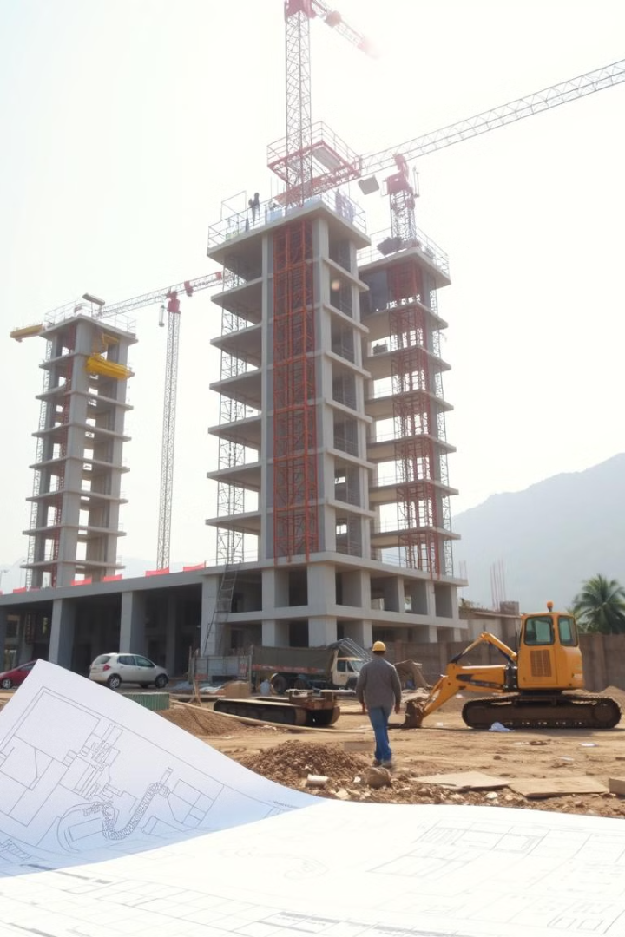
Condition for Eligibility of Tourism Units:
1
First Investment
The date of purchase or work order
or
2
Term Loan Disbursement
Obtaining the first disbursement of a term loan is considered an effective step.
or
3
Development Permission
Obtaining development or construction permission is another valid effective step.
CA Prakalp Sarda
www.hotelsubsidy.com

Slide 11
Capital Incentive:
The policy offers capital incentives for all eligible tourism units, with varying percentages based on the category of the project. These incentives are designed to encourage investment in different types of tourism facilities across the state.
Accommodation Units
20% of ECI capped at INR 20 crores for Category A.
15% of ECI capped at INR 15 Crores for Category B.
Other Units
15% of ECI capped at INR 15 crores for Food & Beverages, Travel & Tourism, and Entertainment & Recreation.
15% of ECI capped at INR 10 crores for Other Tourism Units
Ultra Mega Projects
10% of ECI capped at INR 25 crores
#ECI - Eligible Capital Investment. *In five fixed annual installment
Additional Incentive of 5% for Women Entrepreneurs/SC/ST/Differently abled
www.hotelsubsidy.com

Slide 12
Stamp Duty & Registration Charges Exemption:
1
Zone A
50% of cost exempted
2
Zone B
75% of cost exempted
3
Zone C, STZ/STD, Ultra Mega
100% of cost exempted
CA Prakalp Sarda
www.hotelsubsidy.com

Slide 13

SGST Reimbursement:
1
Zone A
50% of Net SGST paid for Eligibility Period
2
Zone B
75% of Net SGST paid for Eligibility Period
3
Zone C & STZ/STD
100% of Net SGST paid for Eligibility Period
4
Ultra Mega Projects
100% of Gross SGST payable for Eligibility Period
CA Prakalp Sarda
www.hotelsubsidy.com

Slide 14

Electricity Duty Exemption:
1
Zone A
50% exemption for eligibility period
2
Zone B
75% exemption for eligibility period
3
Zone C & STZ/STD
100% exemption for eligibility period
4
Ultra Mega Projects
100% exemption for eligibility period
CA Prakalp Sarda
www.hotelsubsidy.com

Slide 15

Electricity Tariff Refund:
1
Zone A
50% difference covered for eligibility period
2
Zone B
75% difference covered for eligibility period
3
Zone C & STZ/STD, Ultra Mega Projects
100% difference covered for eligibility period
4
Calculation
Difference between commercial and industrial tariff
CA Prakalp Sarda
www.hotelsubsidy.com

Slide 16

Interest Subventions on Loans:
Zone
Subvention
Loan Value
Overall Ceiling
A
Up to 5%
INR 5 Crore
INR 20 Lakhs
B
Up to 5%
INR 10 Crore
INR 25 Lakhs
C, STZ/STD
Up to 5%
INR 15-20 Crore
INR 30-50 Lakhs
Ultra Mega Project
Up to 5%
INR 25 Crore
INR 75 Lakh
CA Prakalp Sarda
www.hotelsubsidy.com

Slide 17


Quality Certification Incentives:
1
National Certification
100% reimbursement, capped at INR 2 lakh
2
International Certification
100% reimbursement, capped at INR 10 lakh
3
Eligible Costs
Certification fees and 50% of consulting costs
4
Requirement
Only certifications recognized by Department MoT eligible
CA Prakalp Sarda
www.hotelsubsidy.com

Slide 18
Sustainability Initiatives Incentive:
1
Reimbursement
Actual GST paid on sustainability initiatives
2
Cap
Lower of INR 25 lakhs or 25% of investment cost
3
Eligible Initiatives
Installation of Pollution Control Device, Onsite waste converter
Installation of waste water treatment, Rain water Harvesting
Installation of renewable energy generation
Installation of passenger and utility electric vehicle
others
CA Prakalp Sarda
www.hotelsubsidy.com

Slide 19
Incentives for Tour Operators, Agents DMC for Inbound Tourist:
The policy offers specific incentives for tour operators, agents, and Destination Management Companies (DMCs) focusing on inbound tourism. These incentives aim to promote Maharashtra as a preferred destination for various types of tourism.
Type
Minimum Pax
Minimum Annual Turnover
Tax Rebate
Travel operator
500
INR 20 Lakh
12%-15%
MICE Tourism
1500
INR 10 crore
12%-15%
Destination Wedding
1000
INR 75 Lakh
12%-15%
Medical Tourism Operator
500
INR 20 Lakh
15%
CA Prakalp Sarda
www.hotelsubsidy.com

Slide 20




Miscellaneous Incentives:
Hospitality Related Training
Tourism Exhibitions Participation
Rural Tourism Fair Organization
YUVA Tourism Incentive
75% of cost capped at INR 12,000 for units sending employees for training through reputed accredited institutes.
50% of cost of rental for stall / space capped at INR 2 to 5 lakhs, for maximum 5 national and 5 international participations in a year.
INR 5 to 10 lakh per organizer per year for minor and major fairs, maximum 3 events per year per organizer.
One-time grant of INR 25,000 for one-year for Youth Clubs promoting tourism.
CA Prakalp Sarda
www.hotelsubsidy.com

Slide 21
Non-Fiscal Incentives:
This policy offers 13 non-fiscal benefits to eligible tourism units. Some of these benefits include:
1
Incentive for Agro Tourism
Agro Tourism licenses are valid for 10 years.
Electricity will be charged at the domestic rate.
2
Incentive for Caravan Tourism
Caravan vehicles will be designated as Tourist Vehicles.
Local authorities will provide parking permits.
3
Additional FSI
Procurement of additional FSI (floor space index) at a lower premium than the current market rate.
4
Other Non Fiscal incentive
Environment and fire clearances will be issued within 1 month.
Exemption from NA Tax and Permit. Etc
CA Prakalp Sarda
www.hotelsubsidy.com

Slide 22
Eligible Capital Investment (ECI):
The policy clearly defines what constitutes Eligible Capital Investment (ECI) for tourism projects and what is not included in ECI. This definition is crucial for determining the incentives available to various tourism units.
Eligible Capital Investment
Ineligible Capital Investment
1
Land Cost
1
Land Cost
Eligible specifically for SGST refund only
Ineligible for capital incentives except for SGST refund
Equipment and Infrastructure
2
Intangible Assets
2
Excludes intellectual property rights and goodwill
Includes machinery, transformers, generators, captive power plants
Buildings and Facilities
3
Pre-construction and Consultancy
3
Covers structures, buildings, mechanical, electrical, and plumbing installations, and waste treatment facilities
Expenses and costs of consultants are not eligible
4
Working Capital
4
Fixtures and Fittings
Not considered as part of eligible capital investment
Includes material handling equipment, fixtures, furniture, and fittings
CA Prakalp Sarda
www.hotelsubsidy.com

Slide 23



Thank you
CA Prakalp Sarda
Phone No: 8007305463
Email: caprakalpsarda@gmail.com
Website: www.hotelsubsidy.com
Address: 1st Floor, Avtar Meherbaba
Society, near bhole petrol pump
Nagpur, 440010
Nagpur/Mumbai/Pune/Amravati/Washim

