Slide 1
Unique Document Identification Number
(UDIN)
Digital Attestation of documents by practising Chartered Accountants

Slide 2
Need for UDIN
  In recent times, many instances have come to light wherein documents are being certified/attested by third persons in lieu of our CA members.
  To curb the forgery, the concept of UDIN has been put into place by Professional Development Committee of the ICAI.
  It allows access to the stakeholders of the documents issued by the Chartered Accountants to check the authenticity of the documents/ reports/ certificates issued by accessing the UDIN portal and thus detect any cases of forgery.
  It is totally secure as it can be viewed only by the Member and/ or the Regulators / other Stakeholders who are having the UDIN. Secondly, it does not contain any information of the client.

Slide 3
What is UDIN
Unique Document Identification Number (UDIN) is a unique number, which will be generated by the system for every document certified/ attested by a Chartered Accountant and registered with the UDIN portal
The UDIN authenticates the certificates and the documents attested by The CA’s as no other person can generate UDIN.
The mechanism has been conceptualized and developed by the Professional Development Committee of the Institute of Chartered Accounts of India (ICAI).

Slide 4
Documents Issued by Chartered Accountants for the following
Goods & Service Tax Act (GST)
Value Added Tax (VAT)
Service Tax Commission (STC)
Banks
Utilisation Certificates
Companies Act
Income Tax Act
Accounting
Auditing
Cost & Financial Management
Direct Taxes
Finance & Capital Market
Financial Management
Indirect Taxes
Information Technology
Insurance & Risk Management
International Taxation
Public Finance & Government Accounting
Foreign Exchange Management Act (FEMA)
Others

Slide 5
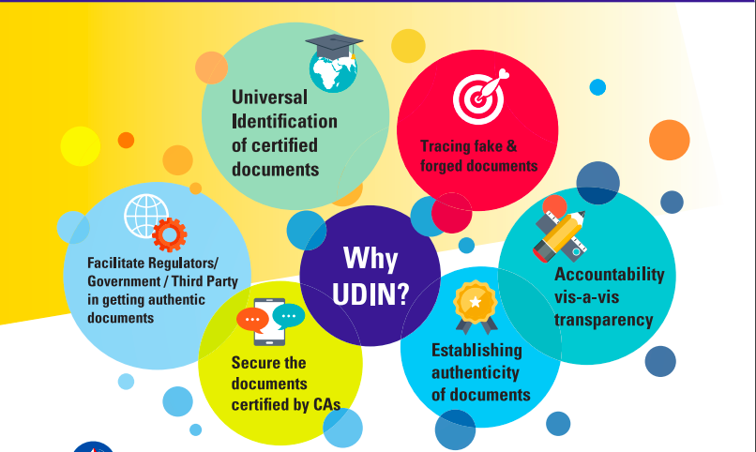

Slide 6
Stakeholders for UDIN
The documents certified by the Chartered Accountants hold immense value since it usually signifies that the CA, in his professional opinion, has ensured that there is no misrepresentation by the entity issuing/submitting such a document.
Such documents are trusted upon by the various stakeholders and any misrepresentations may lead to heavy damages.
The UDIN offers the facility to various stakeholders such as:
  Regulators
  Banks
  Authorities
  Other Stakeholders
  to check the authenticity of the documents by logging in on
  the Portal and verifying the UDIN generated by the CA.

Slide 7
Benefits of UDIN
The generation of UDIN for certifying documents will serve the following purposes:
  It will provide a Unique identification to Certified Documents
  Tracing of forged documents will be easier
  This initiative will facilitate Government and Third Parties in obtaining authentic documents
  It will secure documents certified by CA(s)
  Accountability and transparency in certification can be ensured
  Will work as a check medium for documents certified by persons not CA’s but acting as such.

Slide 8
Unique Document Identification Number (UDIN) has been made mandatory as per the Council decision taken at its 379th Meeting held on 17th – 18th December, 2018 in the following phases:
All Certification done by Practising CAs w.e.f. 1st Feb., 2019.
All GST & Tax Audit Reports w.e.f. 1st April, 2019.
All other attest functions w.e.f. 1st July, 2019
The UDIN is a unique identification number that can only be generated by the Practicing Chartered Accountants.
Hence, only the Full time Practicing CAs’ having a Certificate Of Practice will be able to generate the UDIN to sign the certificates issued by them.

Slide 9
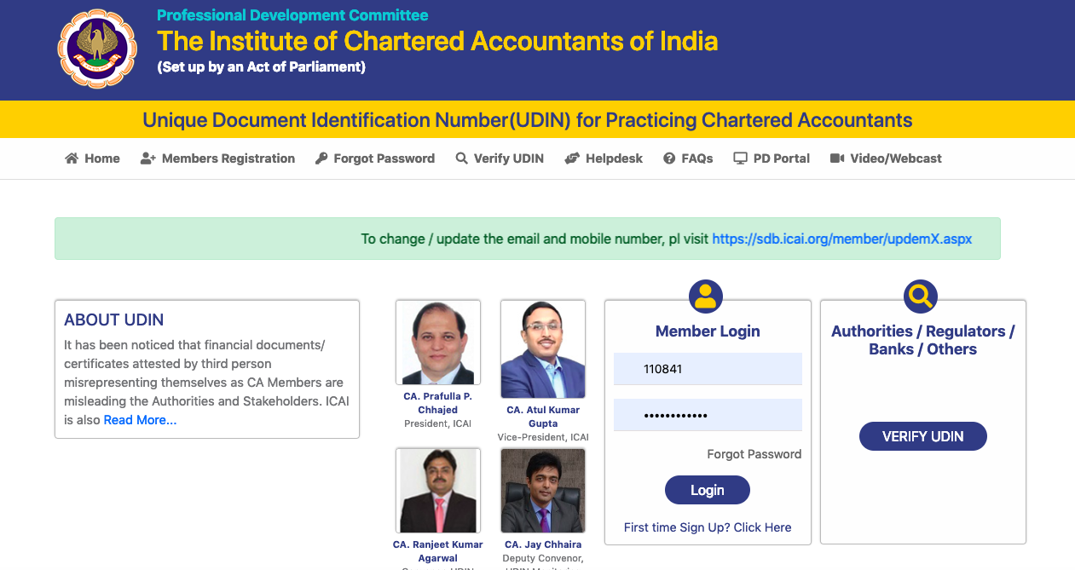

Slide 10
How to Generate UDIN
STEP 1: Registration in UDIN Portal
The UDIN can be generated from the website www.udin.icai.org
The user Chartered Accountant first needs to sign up to the Portal using his Membership Number and other credentials
The same will be verified through OTP on the Email Id and the Mobile Number registered with the Institute.
The user will then receive the Password required for accessing the UDIN Portal on his contact registered with the Institute.

Slide 11
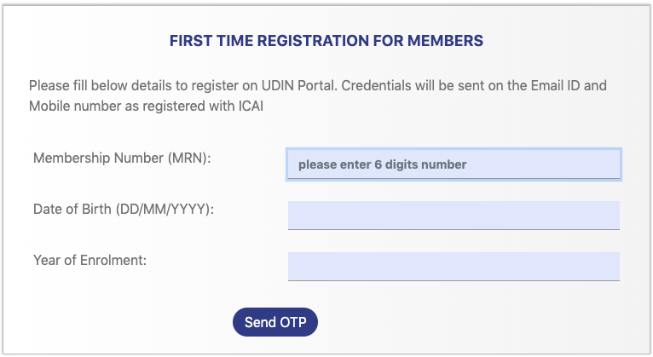
NEW REGISTRATION registered immediately, if not already registered.

Slide 12
The Algorithm of UDIN
The UDIN is a 18 digit system generated number in the following format:
(YY MMMMMM AAAAAAANNN) will comprise of:
YY - Last 2 digits of the Current Year
MMMMMM – ICAI’s Membership No. (6 Digits)
AANNNAANNN –Alpha-numeric generated randomly by the system (10 Digits).
For eg.: 19080108AKTSBN1359

Slide 14
How to Generate UDIN
STEP 2: Logging In
After registration to the Portal, the member has to login to the UDIN portal with the username (i.e. Membership Number) and password at the time of generation of each UDIN.
The initial system generated password can be changed anytime by the member.

Slide 15
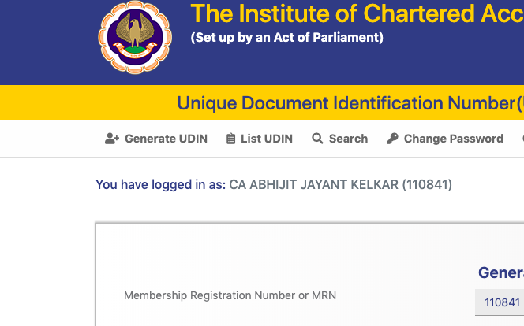
How to Generate UDIN

Slide 16
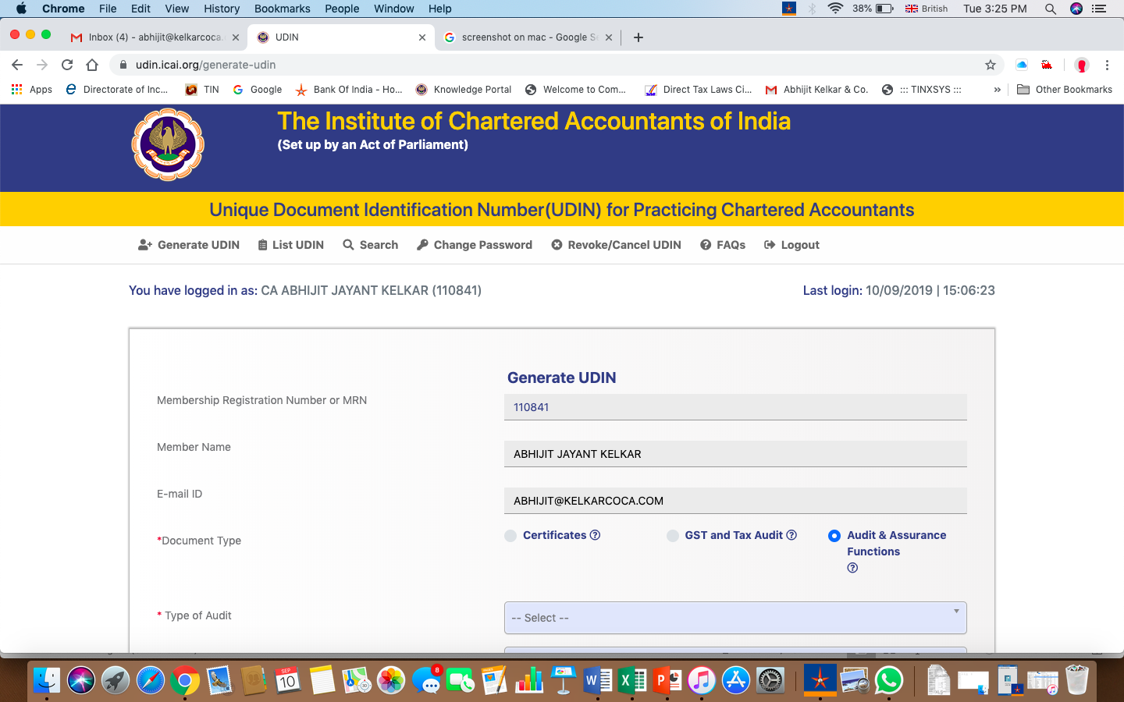
IN Generation Page

Slide 17
STEP 3: Generating UDIN
After Logging in the Member has to click on Generate UDIN.
Membership No
Member Name
Email ID
Document Type – Certificate/GST-IT/Other Audits
Particulars of section/Form under which report issued
Date of Signing report
Key figures
Send OTP

Slide 18
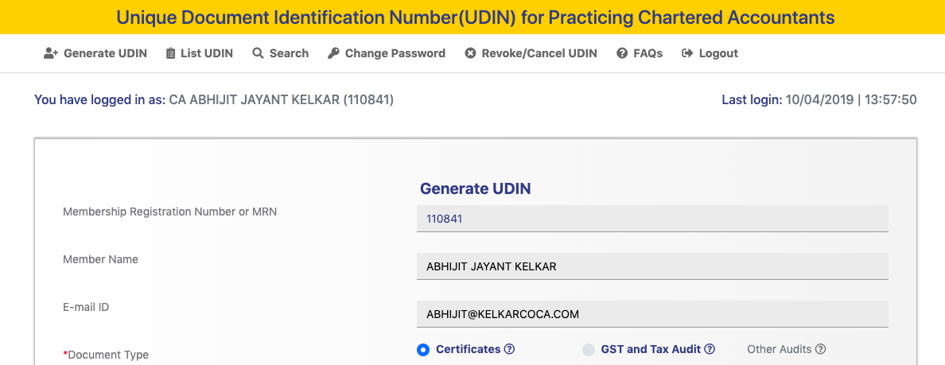

Slide 19
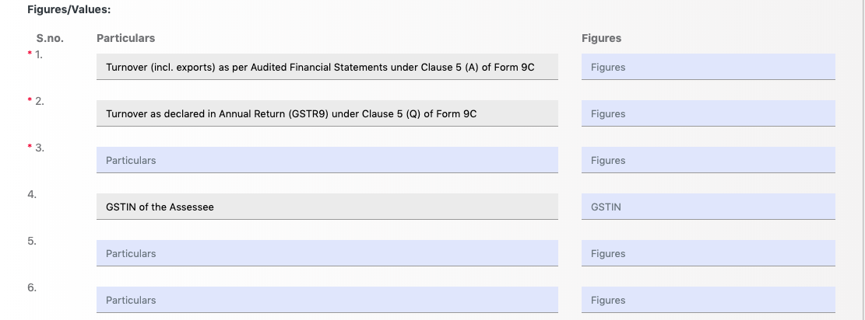
For GST (sec 35(5) of GST) 9C

Slide 20
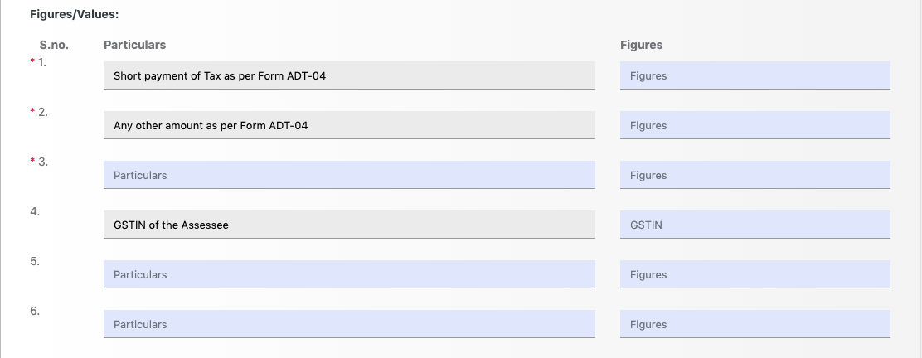
For GST (sec 66(1) of GST) Form ADT-04

Slide 21

After filing in the necessary fields, the member has to click on the ‘generate OTP’ button.
The Portal then sends OTP on the registered Mobile number and Email ID of the Chartered Accountant.
The OTP is generated at the time of creation of each UDIN by the member.

Slide 22
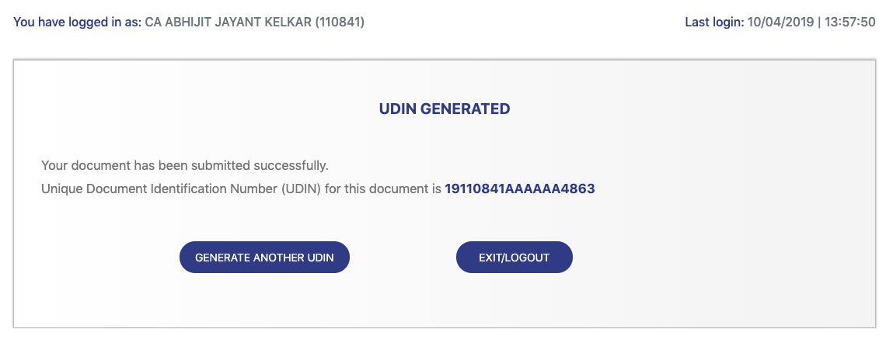
After entering all the specified details and reviewing the same (review button), the request for UDIN is to be submitted.
The UDIN Portal generates the UDIN number for the entered credentials and is displayed on the page.
The UDIN is generated
One can even mention the generated UDIN on the Document manually.

Slide 23
Important
UDIN once generated cannot be edited. A preview option is available after entering all details for generating UDIN for verifying its correctness before Generation i.e. details cannot be included in a draft mode, saved and submitted later.
UDIN will be applicable for manual as well as digitally signed certificates / uploaded online
UDIN can be used for mentioning on the Certificate for which it has been generated, either writing by hand, printing as watermark or printing on certificate itself.
In case of digitally signed / online certificates, UDIN is to be generated and retained for providing the same on being asked by any third party/ authority.

Slide 24
Alteration of UDIN
Once a UDIN for a particular document has been generated, the details of the document corresponding with the UDIN cannot be modified in any manner.
However, there may be a situation where the document may either require certain changes or cancellation altogether.
In such instances, the UDIN once generated can be withdrawn or revoke or cancelled with proper narration by the Member.
Hence if any user search for this UDIN, appropriate narration indicated by Member with the date of revoke will be displayed for reference.

Slide 25

VERIFICATION OF UDIN

Slide 26
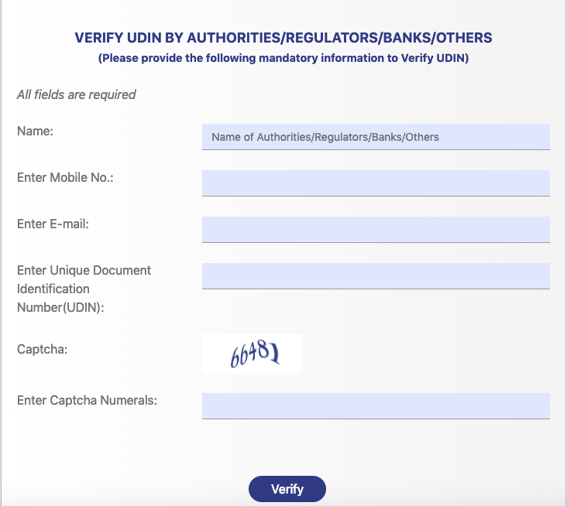
WHEN SEARCHED BY OUTSIDER

Slide 27
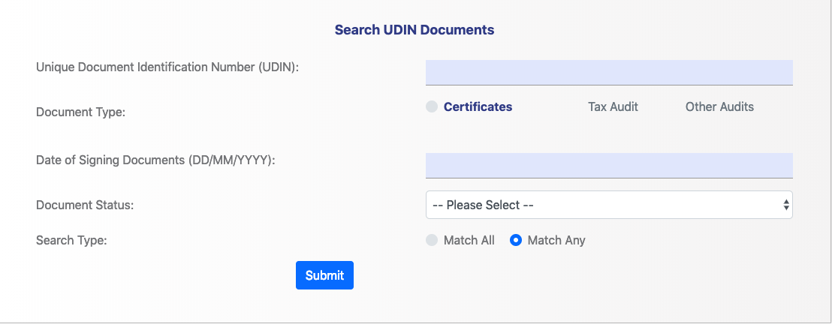
SEARCH BY US

Slide 28
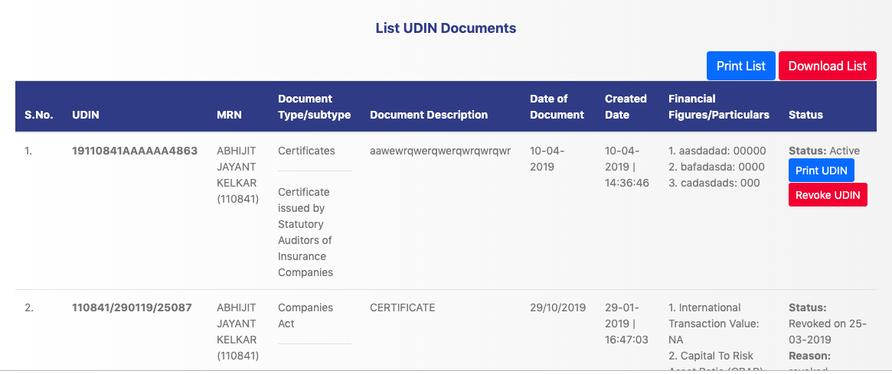
List of Generated UDIN

Slide 29
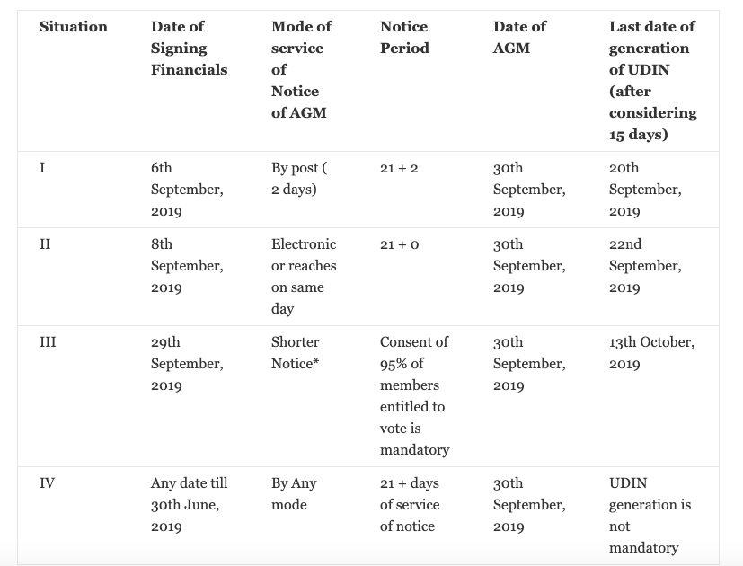

Slide 30
Revocation of UDIN
Revocation of UDIN may be required in case of
UDIN obtained but certificate not issued for specific reason,
UDIN obtained but certificate not issued within 15 days thereof, or
(UDIN obtained and certificate issued but rejected by authority or withdrawn by us for certain reason
Members should note that UDIN can be revoked by mentioning the reason.
Further, there is no time limit for allowing revocation.
If any user (Authorities/Regulators/Banks/Others) had searched that UDIN before revocation, an alert message will be sent about revocation of the UDIN.
After revocation of the UDIN, anybody searches for that UDIN, appropriate narration indicated by Member with the date of revocation will be displayed for that revoked UDIN.

Slide 31
Issues in UDIN
The process of generating the UDIN is a bit time consuming and has to be repeated each time the CA has to sign a document.
This may lead to a bit of discomfort in cases where many documents are to be signed in a short span of time. E.g. The audit reports at the due dates.
However, the hardships faced will be very minute as compared to the benefits enjoyed by the way of stopping forgery and increasing the authenticity of the documents.
UDIN generation is being made mandatory as per the Council Decision of ICAI, hence not generating UDIN for mandatory documents will amount to non-adherence of the Council Decision and may attract disciplinary proceedings as per the Second Schedule Part II of The Chartered Accountants Act, 1949.

Slide 32
Is UDIN required for Certified True Copies also?
Can a Partner generate UDIN for the Certificate signed by another Partner?
Whether UDIN will be applicable only for manually signed documents or also for digitally signed certificates being uploaded online such as Form 15 CB?
Is UDIN required for original Certificate only or for duplicates also?
What is meant by “Date of signing Document”?
What if there are no financial figures?
Sometimes there are multiple reports in one Assignment. Is separate UDIN is to be generated for all such reports?
Is UDIN required to be mentioned on every page of the Document or it can be mentioned at the last?
For Tax Audit under Section 44AB, whether separate UDIN is required for Audit Reports like Form 3CA/3CB and Form 3CD?
Under various Key Fields, the figures pertaining to which date are to be entered for generating UDIN?

Slide 33
What is to be mentioned under Shareholder Fund/Owner’s Fund?
Under the Keyword “Shareholders Fund/ Owner’s Fund” figures appearing under Owner Funds / Shareholding / Capital Investment / Equity Share / Equity Interests / Share Ownership / Capital Account / Partners’ Capital /Capital Providers / Stockholder / Venture Capitalists /Own Capital / Endowment Fund/ Corpus Fund /General Fund etc. inclusive of Reserve and Surplus is to be mentioned irrespective of the term used in the Financial Statement.

Slide 34
Whether UDIN is required on Prospective Financial Statements / Information?
As per clause (3) of part-I of Second Schedule to the Chartered Accountants Act, 1949, a member in practice will be deemed to be guilty of professional misconduct if he engages in estimation of earnings contingent upon future transaction in a manner which may lead to the belief that he vouches for the accuracy of the forecast.
As per opinion of the Council, a Chartered Accountant can participate in the preparation of profit or financial forecasts and can review them, provided he indicates clearly in his report the sources of information, the basis of forecasts and also the major assumptions made in arriving at the forecasts and so long as he does not vouch for the accuracy of the forecasts. The member

Slide 35
Whether UDIN is required on Provisional Financial Statements / Compilation of Information?
Standard on Related Services (SRS) 4410 “Compilation Engagements” deals with the concept. Provisional Financial Statements / Compilation of Information may be prepared as per this standard. The purpose of this Standard is to establish standards on professional responsibilities of an accountant when an engagement to compile financial statements or other financial information is undertaken and the form and content of the report to be issued in connection with such a compilation so that the association of the name of the accountant with such financial statements or financial information is not misconstrued by a user of those statements or information as having been audited by him.
The member has to comply with SRS 4410 while preparing Provisional Financial Statements / Compilation of Information and has to obtain UDIN for the same.

Slide 36
Resolution of Queries
For any queries or assistance related to the UDIN portal, the following helpline has been provided by the Institute of Chartered Accountants of India:
PDC Department – (011) 3011 0444.
The queries can also be mailed at udin@icai.in

Slide 37
CA. ABHIJIT KELKAR
B.COM, LL.B, FCA, DISA
9422126890 / 9096021215 abhijit@kelkarcoca.com www.kelkarcoca.com
Thank you for patient hearing!!

