Slide 1
WHETHER TDS IS TEDIOUS? LAWS AND INTERPRETATIONS
By CA SAKET BAGDIA, NAGPUR
9823272345
casaket123@gmail.com

Slide 2
Just like that-
TDS / TCS has become a major source of revenue for Government. It is like that an SIP for the Government to function throughout the year.
Every year new sections are added or modified to extend the scope and applicability of TDS / TCS provisions.
As Auditors it becomes all the more important for us as we are required to confirm in our Tax Audit Report that all TDS / TCS provisions has been complied with completely.
Particular situation at any point of time and content therein is more relevant rather than interpretation of Sections.
It’s a very large and extensive topic and hence we would cover only the important TDS / TCS Sections intricacies.
For ease of discussion and reference I have covered the TDS Rate Chart and then relevant TDS / TCS sections have been elaborated

Slide 3
Applicability of TDS-
TDS Applicable irrespective of Turnover limit for –
- Companies
- Partnership Firms
- LLP
- Other than Individual / HUF; subject to various exemptions.
TDS Applicable only when Total Sales / Gross Receipts / Turnover exceeds Rs. 1 Crore for Businesses / Rs. 50 lacs for Professionals in case of Individual / HUF during the financial year immediately preceding the financial year in which sum sums are credited or paid.
TDS to be deducted at the time of receipt of amount or credit in books (by whatever name called) whichever is earlier.
Remember in some sections it is –
TDS to be deducted at the time of payment or credit in books, (194C, 194J etc.)
Before Making any payment, (194, 194R etc.)

Slide 4
TDS under the new Income Tax Bill
Covered under Chapter XIX – Collection and recovery of Tax
Consolidation of TDS provisions: TDS provisions (previously spread across Sections 192 to 194T) are consolidated into Section 393 for easier reference. TCS provisions are enumerated in Section 394. Total Chapter covers Section 390 to Section 402.
No Changes in Slabs /rate of tax except change of section and all clauses being covered under one single section instead of various sections.

Slide 5
Whether Statutory Auditor of a Company can file TDS returns???
An auditor shall provide to the company only such services as are approved by the Board of Directors or the audit committee, as the case may be. However, as per section 144 auditors cannot provide following services “directly or indirectly” to the company or its holding company or subsidiary company, namely:— (a) accounting and book keeping services; (b) internal audit; (c) design and implementation of any financial information system; (d) actuarial services; (e) investment advisory services; (f) investment banking services; (g) rendering of outsourced financial services; (h) management services; and (i) any other kind of service as may be prescribed.

Slide 6
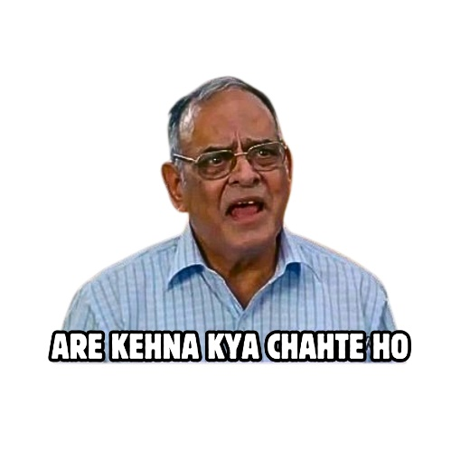
However, the nature of services in the question are grey, i.e. they are neither expressly allowed nor have they been restricted.
The issue is whether they are covered under the term "Management Services", expression the meaning and scope of which has not been explained even till date.
As per general understanding, management services could mean any services as may be provided in relation to the management and/or administration of the company.
As per the Code of Ethics issued by ICAI the expression “Management Consultancy and other Services” shall NOT include the function of statutory or periodical audit, tax (both direct taxes and indirect taxes) representation or advice Concerning tax matters or acting as liquidator, trustee, executor, administrator, arbitrator receiver.

Slide 7
Conclusion…
In a publication by ICSI following check was laid down:
Whether a particular service falls within management service under section 144(h) of the Companies Act, 2013 and hence is restricted, should be assessed on the following considerations:
1. Whether the service is within the purview of management services read with Regulation 190A;
2. Whether by rendering such a service the auditor is not performing any managerial function or not making any managerial decisions;
3. Whether the auditor is merely reviewing and reporting on the work done by the audit client or by a third-party specialist employed by the audit client because, in such a situation the “third party or the audit client is the source of the financial information subject to the review or audit” and “the auditor will not be reviewing or auditing his or her own work.
If the answers to above three considerations are in affirmative then such a service is not restricted under section 144(h) of the Companies Act, 2013.
For instance: Filing VAT/ Service Tax Returns (Now GST), Filing IT/ TDS Returns, Filing ROC forms which are not to be certified by any professional, Issuing opinions on Tax, FEMA or other issues etc. do not fall under the definition of Section 144(h) of the Act.
In view of the above literature, I am of the opinion that an auditor can take up filing work of returns of company and shall not violate section 144 in doing so.

Slide 8
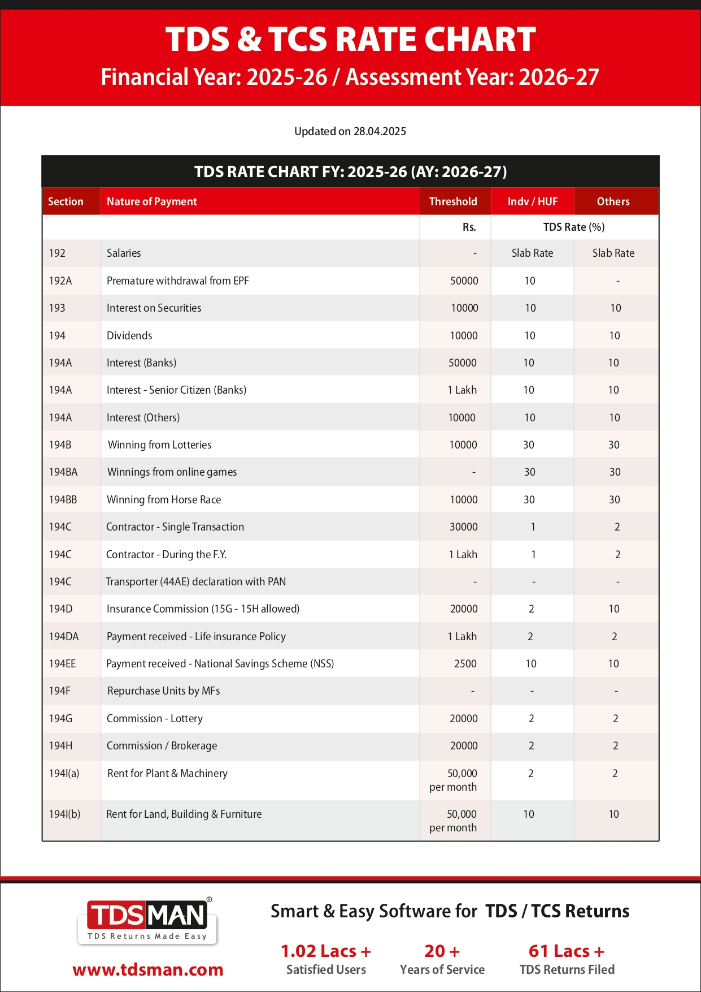
TDS Rate Chart Page 1

Slide 9
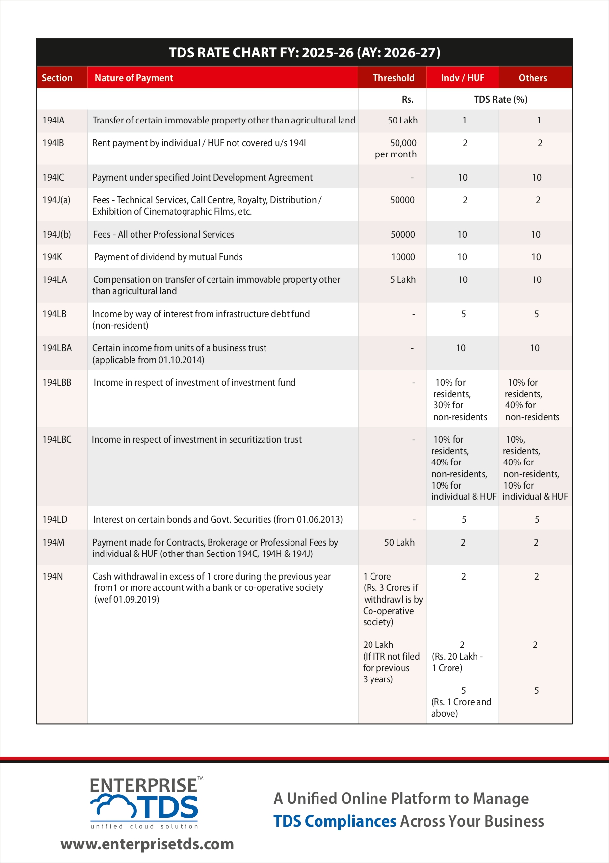
TDS Rate Chart Page 2

Slide 10
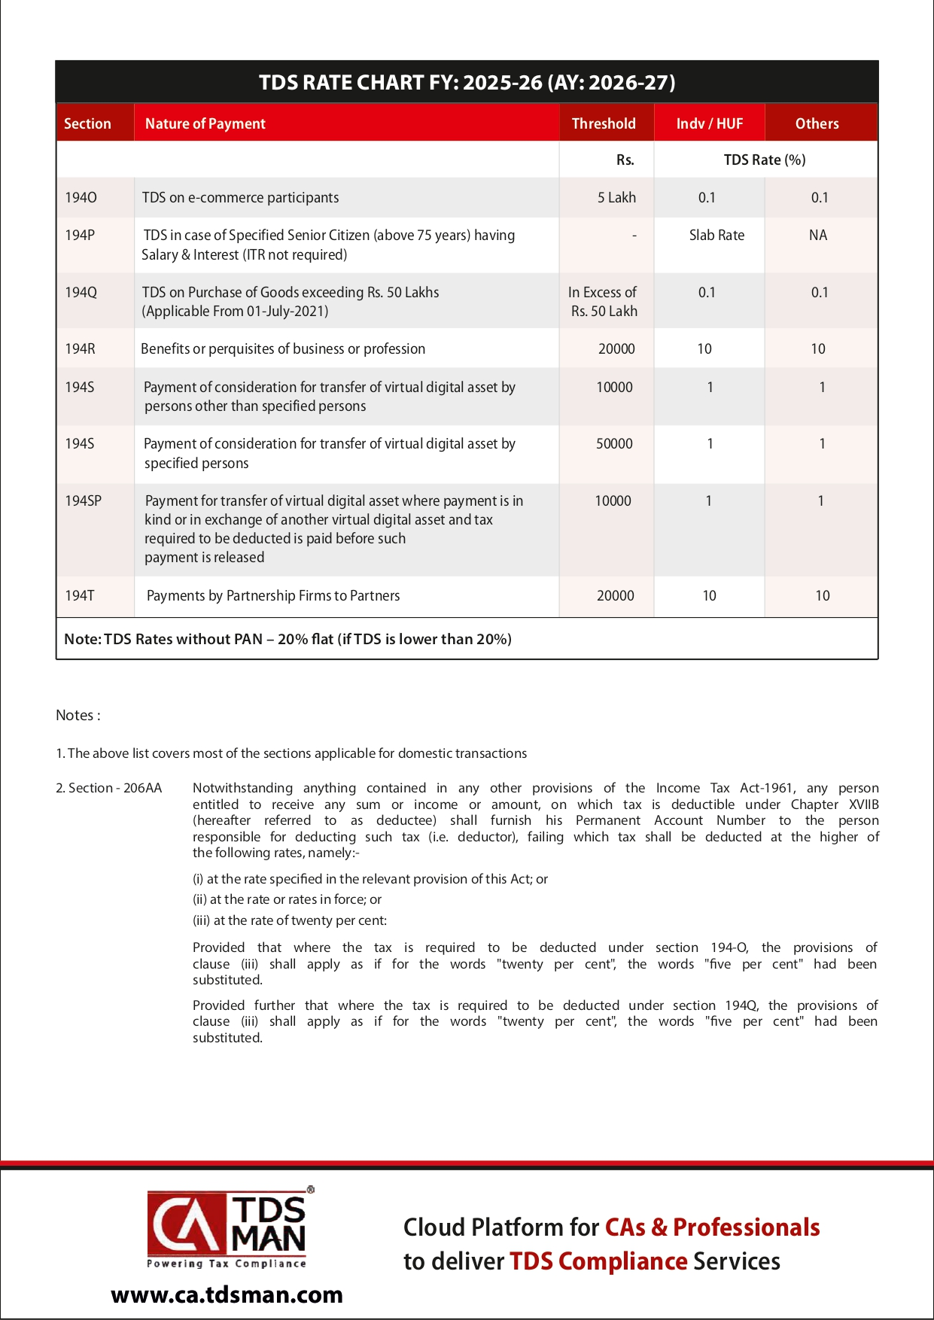
TDS Rate Chart Page 3

Slide 11
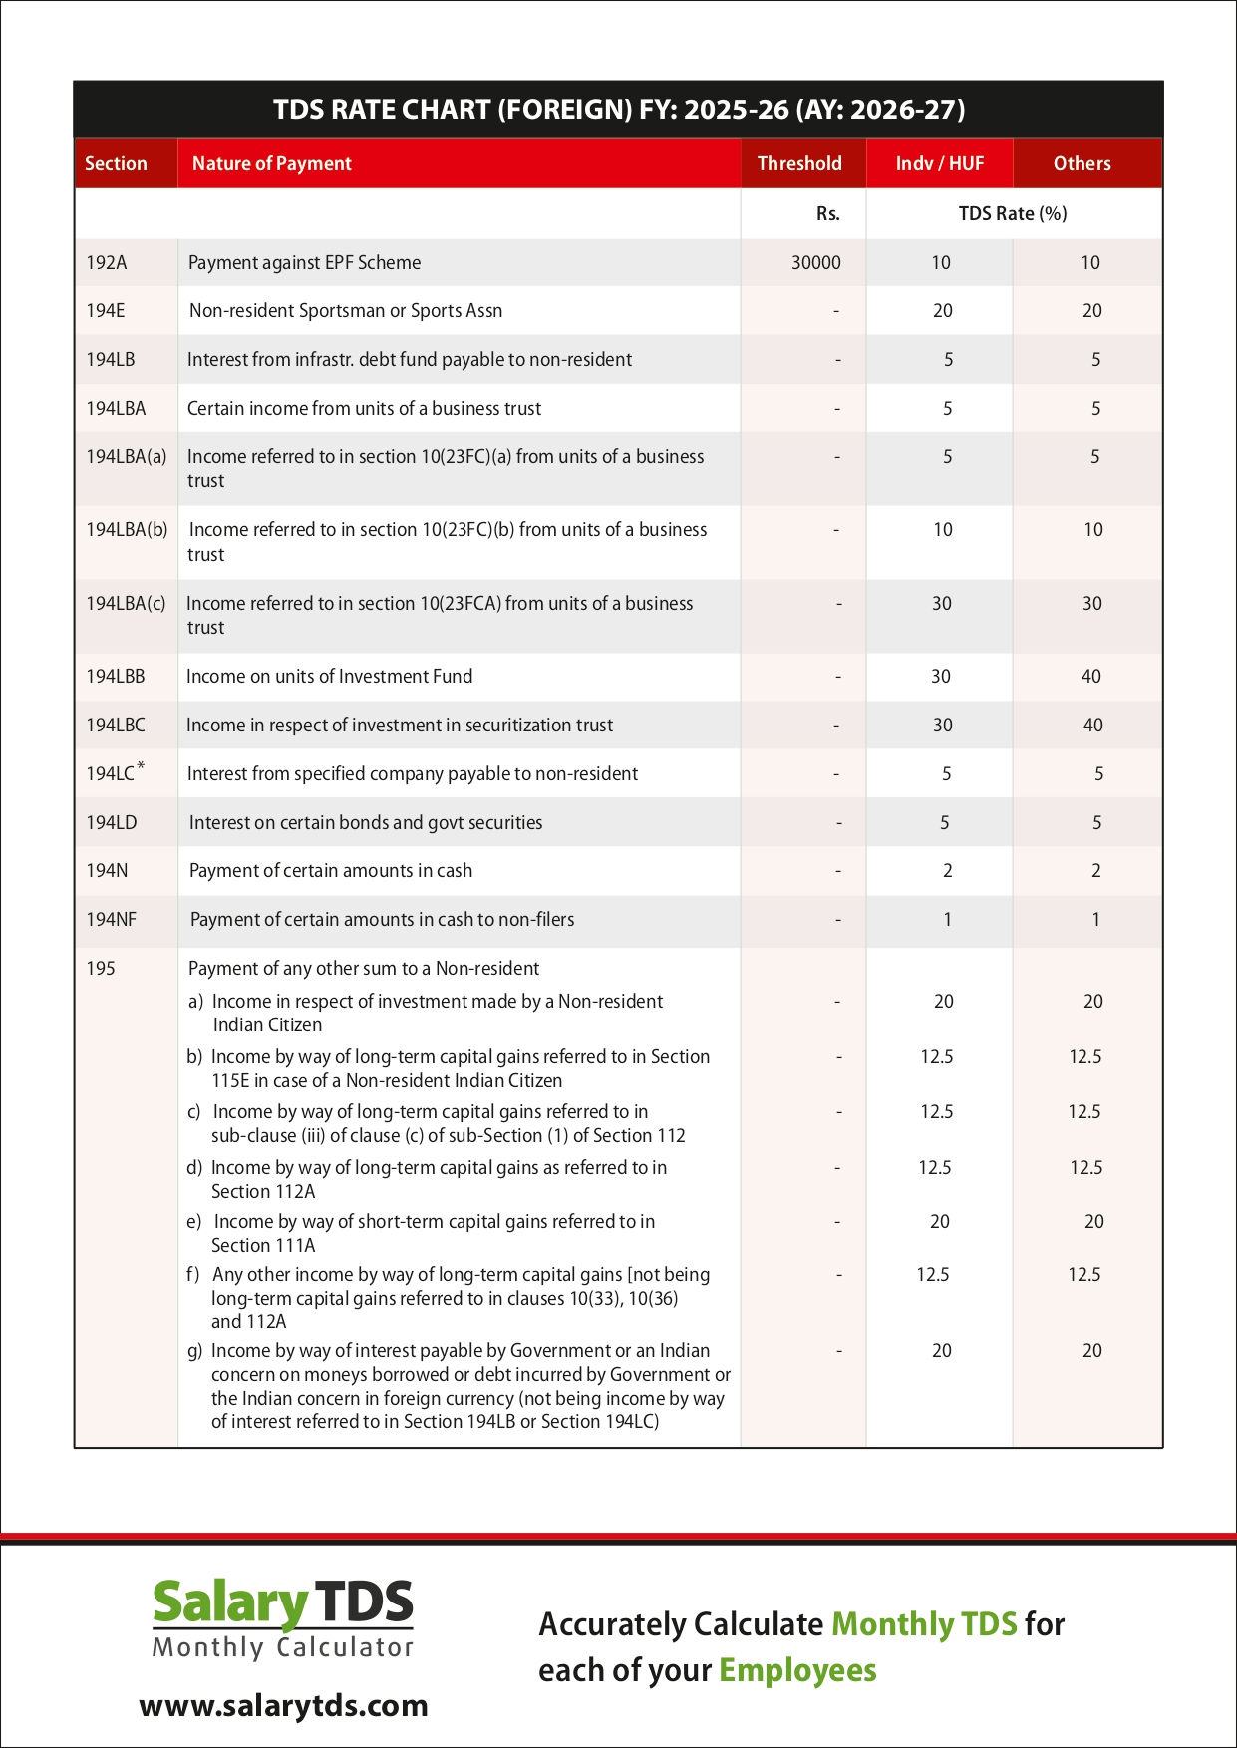
TDS Rate Chart Page 4

Slide 12
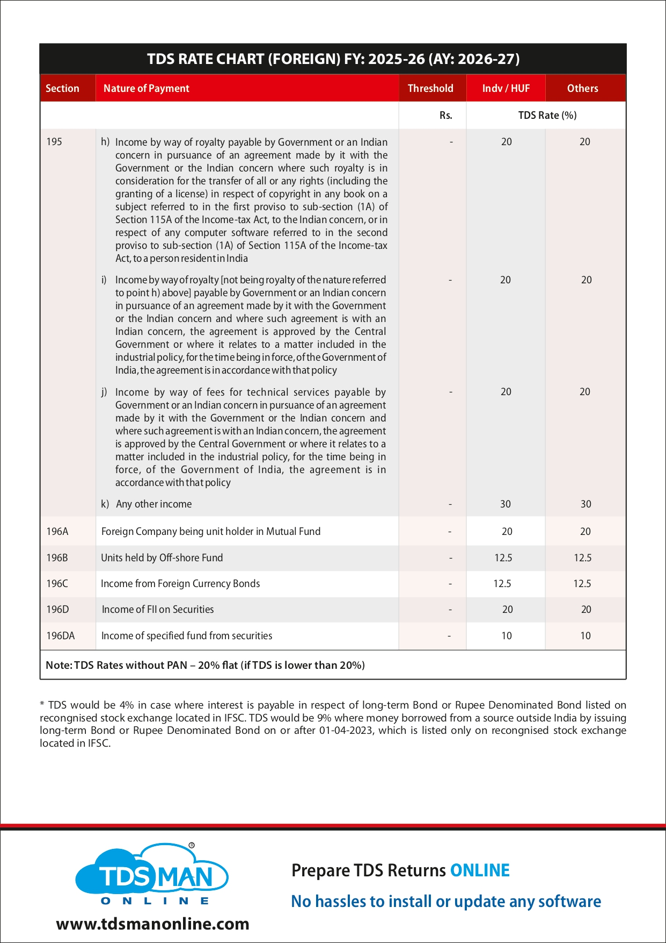
TDS Rate Chart Non Resident Page 5

Slide 13
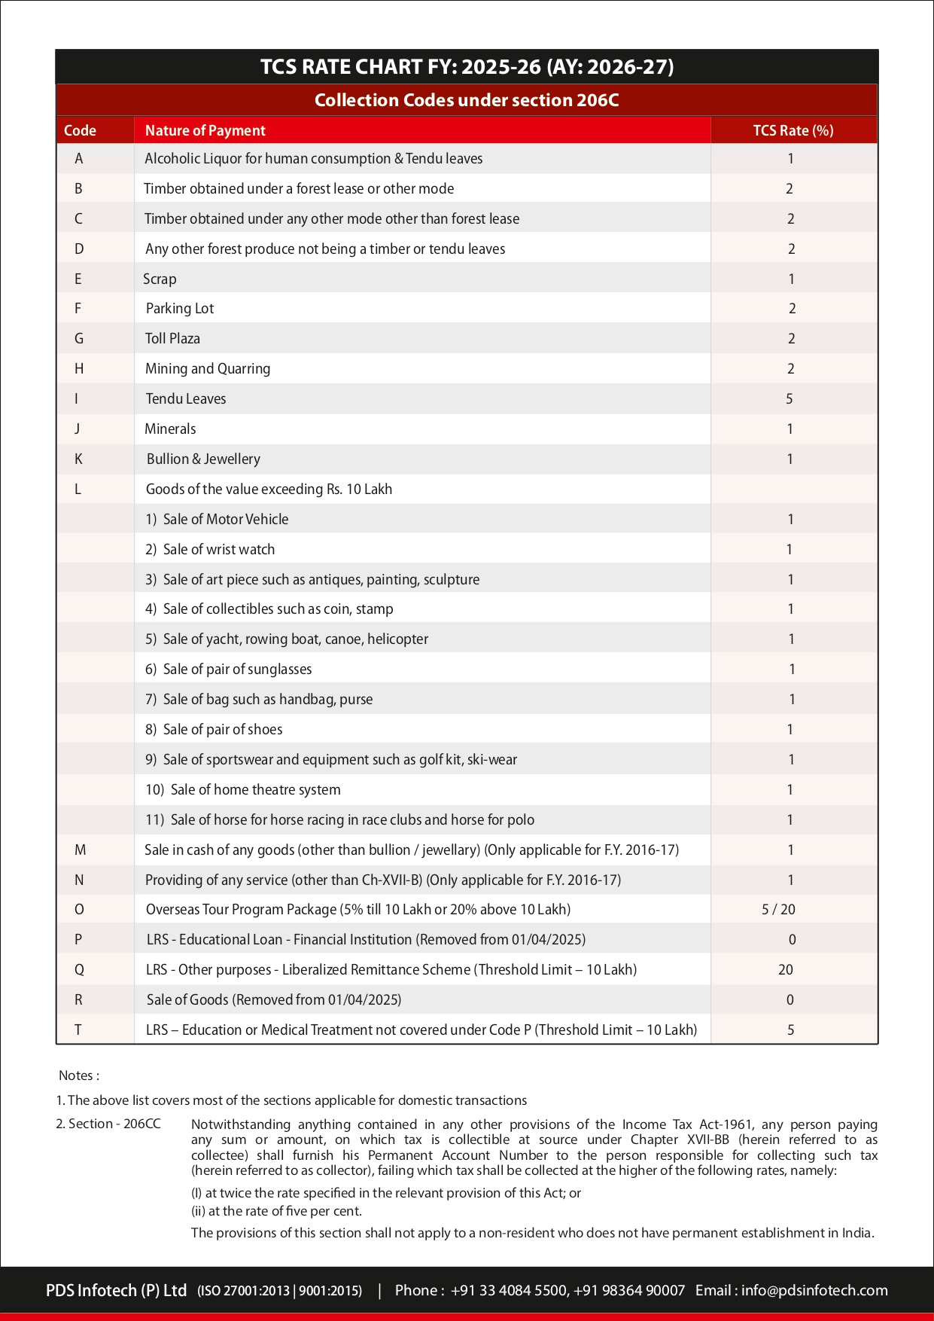
TCS Rate Chart Page 6

Slide 14
Problem Area for all of us??
TDS u/s 194T –
With effect from 1-4-2025, Section 194T(1) provides that any person, being a firm, responsible for paying any sum in the nature of salary, remuneration, commission, bonus or interest to a partner of the firm, shall, at the time of credit of such amount to the account of the partner (including the capital account) or at the time of payment thereof, whichever is earlier, deduct income-tax thereon at the rate of ten per cent sub-section (2) of the said section provides that no deduction shall be made under subsection (1) where such sum or, the aggregate of such sums credited or paid or likely to be credited or paid to the partner of the firm does not exceed twenty thousand rupees during the financial year.

Slide 15
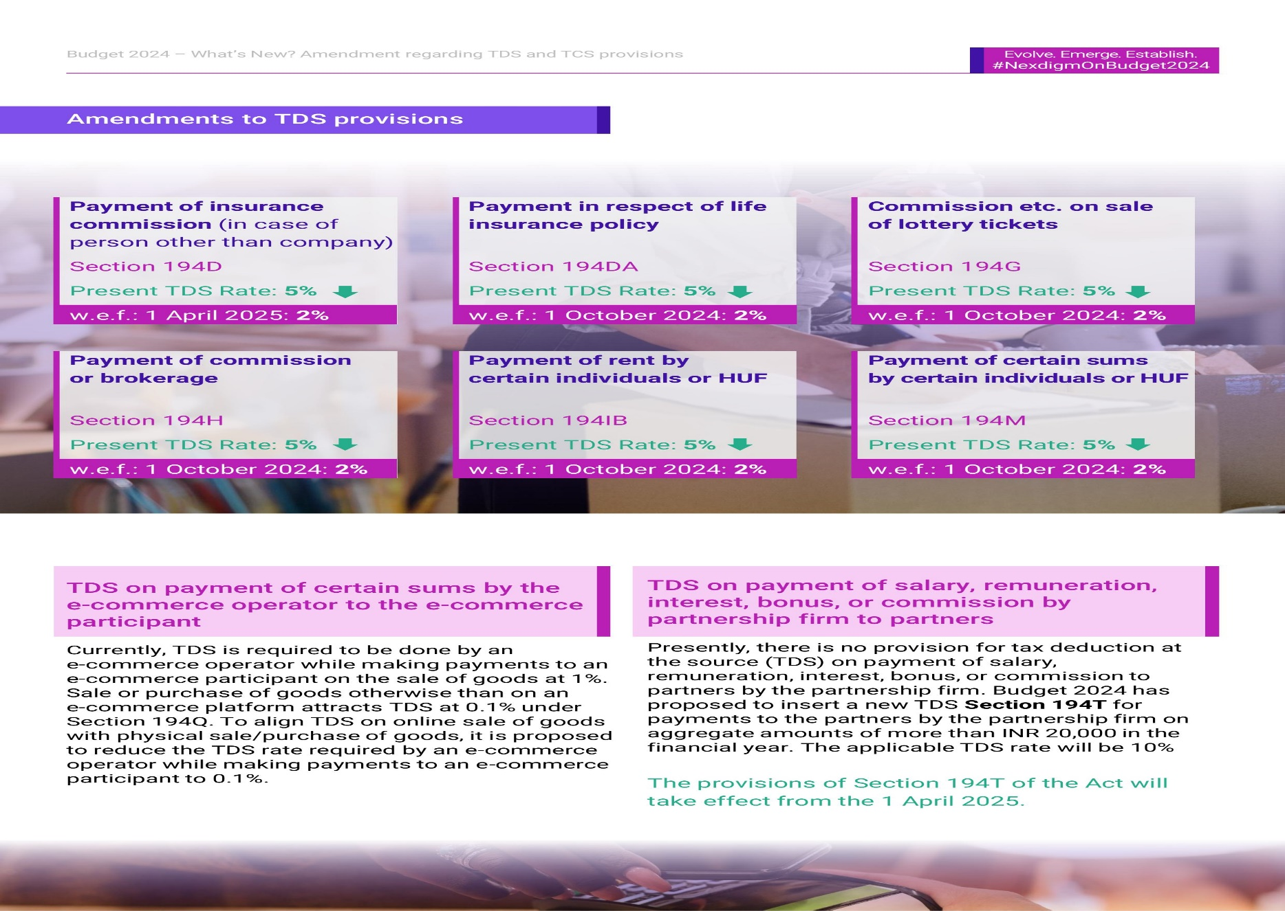
TDS amendments 2025..

Slide 16
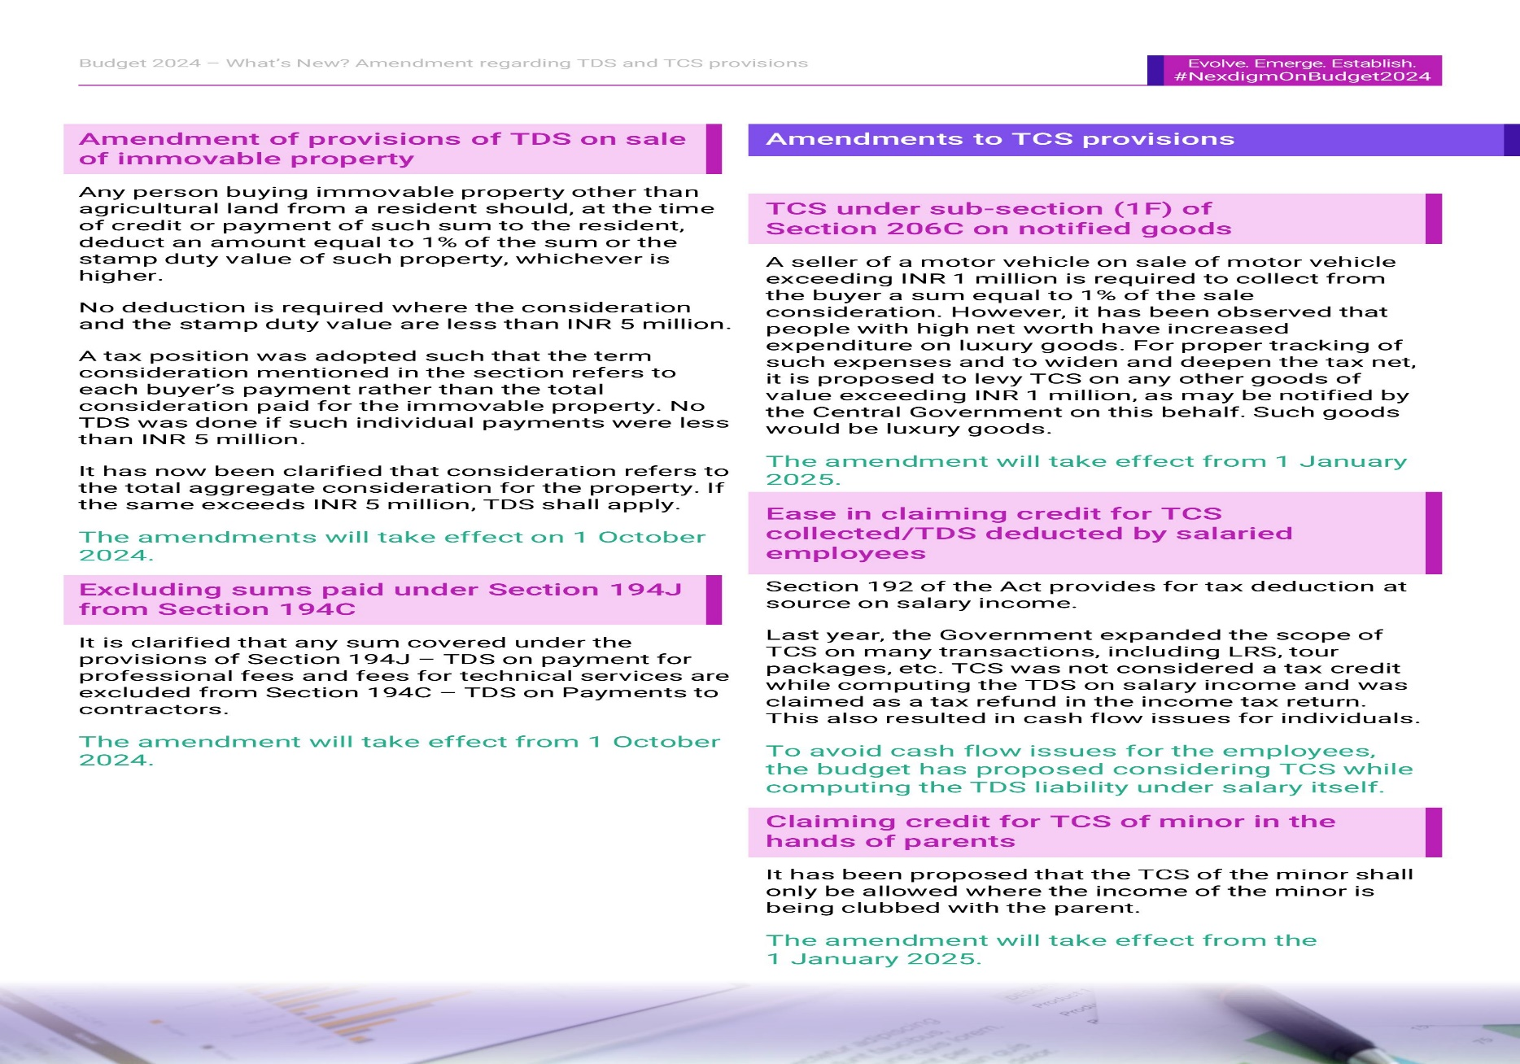
TDS Amendments 2025…

Slide 17
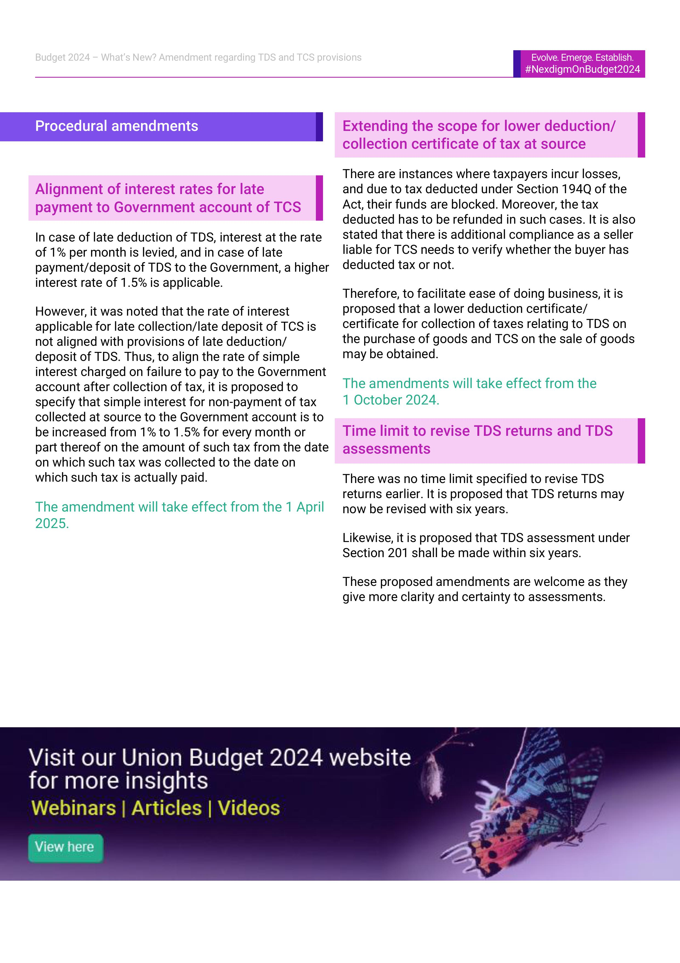
TDS Amendments 2025..

Slide 18
TDS other amendments
Lower of TDS and TCS certificates can be applied for Section194Q
and Section 206C(1H). However now 206C(1H) stands cancelled
w.e.f. 01.04.25
Interest rate increased from 1% to 1.5% where TCS collected but not deposited to government
Credit of TCS of minor shall be allowed where income of minor clubbed with parent u/s. 64(1A)
Exemption from penalty for delayed filing of TDS return limited from one year to one month from due date of filing return.
No order can be issued treating a person as assessee in default for
failing to deduct or collect tax after
6 years from the end of FY of payment or credit OR
2 years from the end of FY when correction statement delivered
Whichever is later

Slide 19
Section 194IA – Payment on transfer of certain immovable property other than agricultural land
Section 194-IA(1) provides for deduction of tax by any person responsible for paying to a resident any sum by way of consideration for transfer of any immovable property (other than agricultural land) at the time of credit or payment of such sum to the resident at the rate of 1% of such sum as income-tax thereon. Sub-section (2) provides that no deduction of tax shall be made where the consideration for the transfer of immovable property is less than fifty lakh rupees.
The amended section 194-IA of the Act to provide that in case of transfer of an immovable property (other than agricultural land), TDS is to be deducted at the rate of one per cent. of such sum paid or credited to the resident or the stamp duty value of such property, whichever is higher.
It is further amended sub-section (2) of the said section to provide that no deduction of tax shall be made where the consideration for the transfer of immovable property and the stamp duty value of such property, are both less than Rs. 50 Lakh.
Clause (c) to the Explanation defines “stamp duty value”. Stamp duty value shall have the meaning assigned to it in clause (f) of the Explanation to clause (vii) of sub-section (2) of section 56.
“Consideration for transfer of any immovable property” shall include all charges of the nature of club membership fees, car parking fees, electricity or water facility fees, maintenance fee, advance fee or any other charges of similar nature, which are incidental to transfer of the immovable property.

Slide 20
Lets discuss few issues for Section 194IA:
Sale Deed Value – 60 lacs
- Scenario 1 – 2 Buyers & 2 Sellers ??
- Scenario 2 – 2 Buyers & 1 Seller ??
- Scenario 3 - 1 Buyer & 2 Sellers ??
What would be the date to be put for Form 26QB filling in a scenario where there is no formal written agreement?
Whether TDS refund can be claimed in case of cancellation of agreement / deal?

Slide 21
Section 194IA
Issue resolved-
In case of transfers involving multiple transferors and/or transferees, the exemption limit of INR 50 lakhs is proposed to apply on an aggregate basis for an immovable property. The amendment will take effect from 1 October 2024 and is expected to bring clarity for deductor’s while applying these provisions.

Slide 22
Section 194IB. Payment of rent by certain individuals or Hindu undivided family
(1) Any person, being an individual or a Hindu undivided family (other than those referred to in the second proviso to section 194-I), responsible for paying to a resident any income by way of rent exceeding fifty thousand rupees for a month or part of a month during the previous year, shall deduct an amount equal to five per cent (2% w.e.f. 01.10.24) of such income as income-tax thereon.
(2) The income-tax referred to in sub-section (1) shall be deducted on such income at the time of credit of rent, for the last month of the previous year or the last month of tenancy, if the property is vacated during the year, as the case may be, to the account of the payee or at the time of payment thereof in cash or by issue of a cheque or draft or by any other mode, whichever is earlier.
(3) The provisions of section 203A shall not apply to a person required to deduct tax in accordance with the provisions of this section.
(4) In a case where the tax is required to be deducted as per the provisions of Section 206AA such deduction shall not exceed the amount of rent payable for the last month of the previous year or the last month of the tenancy, as the case may be.
Explanation.—For the purposes of this section, “rent” means any payment, by whatever name called, under any lease, sub-lease, tenancy or any other agreement or arrangement for the use of any land or building or both.

Slide 23
Sec 194N – Payment of certain amounts in Cash
Every Person being a Banking Company, Co-op Society engaged in Banking or Post Office, paying Cash exceeding Rs. 1 crore to any person from one or more accounts maintained by the recipient with it, shall deduct TDS @2%,
In case if the withdrawer has not filed his ROI for last 3 years; Limit of cash withdrawals would be 20 lacs instead of Rs. 1 crore and TDS would be deducted @2% up to Rs. 1 crore and over and above that @5%
TDS only on the amount exceeding the threshold.
Provided further that where the recipient is a co-operative society, the turnover criteria would be revised to 3 crores instead of 1 crore for deduction of tax u/s 194N.

Slide 24
Section 194Q & Section 206C(1H)
Basis of Distinction | TDS on purchase of goods (Section 194Q) | TCS on Sale of Goods (Section 206C(1H)
Who is liable for deduction / collection | Buyer is liable to deduct tax | Seller is liable to collect the tax
Turnover Limit of deductor / collector | Total Sales / Turnover / Gross receipts from business in immediately preceding PY should exceed INR 10 crores – of Buyer | Total Sales / Turnover / Gross receipts from business in immediately preceding PY should exceed INR 10 crores – of Seller
Threshold for purchase / sale | INR 50 lakhs | INR 50 lakhs
Rate | 0.1% | 0.1%
Amount on which tax is to be deducted or collected | On the amount of purchase in excess of INR 50 lakhs | On the amount of sale consideration in excess of INR 50 lakhs
Time of collection / deduction | At the time of payment or credit whichever is earlier | At the time of receipt
Preference | First | Second

Slide 25
Section 194Q & Section 206C(1H)
Situation | Buyer’s Details | TDS u/s 194-Q | Seller’s details | TCS u/s 206C(1H)
1 | If the turnover etc of the buyer in the preceding financial year is more than 10 cr, and purchase of goods is Rs. 50 lakhs or more | Yes | NA | NA
2 | Turnover is more than 10 cr, and purchase is less than 50 lakhs | No | Since sales is less than 50 lakhs | No
3 | Turnover is less than 10 cr, and purchase is more than 50 lakhs | No | If turnover is more than 10 cr If turnover is less than 10 cr | Yes No
4 | If turnover is less than 10 cr, and purchase is less than 50 lakhs | NA | Since sales are less than 50 lakhs | No

Slide 26
Section 194Q – Salient Points
Buyer responsible for paying any sum to a Resident, for purchase of any goods; Of the value or aggregate value exceeding Rs. 50 lakhs in any previous year; To deduct tax at source at the time of credit or payment whichever is earlier; Rate of tax – 0.1% of the amount exceeding Rs. 50 lakhs
Sec 194Q does not apply in cases-
- Where Tax deductible under any of the provisions of this Act,
- Tax is collectible under the provisions of Section 206C other than a transaction to which sub section (1H) of Section 206C applies.
TDS to be done on amount net of GST.
In case of non availability of PAN, TDS deductible @5%
Section 194Q applies to purchases of both revenue and capital goods.
Scenarios?
Whether 194Q applicable in case of Goods purchased from SEZ / EOU?
TDS on services purchased???
Whether the purchases made from a single seller from different locations/units to be aggregated?
Whether TDS to be made from payment in respect of transaction in electricity?
Purchase of Jewellery? Purchase from Non Residents?

Slide 27
Section 194R: TDS on benefit or perquisite of a business or profession
TDS u/s 194R on Business Promotion Expenses shall be applicable as follows –
This Section has far reaching implications even in the hands of the recipients of the Business Promotion Expenditure.
The TDS is applicable on Any Resident who is providing any benefit/perquisite to another Resident.
The Benefit/Perquisite has to be in kind and arising from Business & Profession (BP).
TDS should be deducted at 10% on the value or aggregate of value of such benefit or perquisite.
TDS should be deducted before providing such benefit or perquisite.
TDS applicable even when cash is not sufficient for payment of the same.
No TDS in case of benefit/perk per person is not more than 20,000 in a FY.
No TDS when deductor is an Individual / HUF having turnover less than 1 Crore or 50 lacs as the case may be for Profession.
No TDS for non residents – Buyer / Seller
Value to be ascertained if benefit is in kind.

Slide 28
Section 194R Examples
There must be a circumvention of income by taking or receiving income in other forms to be taxable u/s 28(iv)
An insurance company decided to provide TV of Rs. 50000/- to an agent who clocks insurance premium Rs. 10 Lakhs in one quarter. Now, this will be subject to the TDS provision and the agent has to disclose in his ITR as PGBP .
An Electronics company decided to offer the tour to Dubai for the dealer who makes the purchases Rs. 1 Crore in one year. Now, this will be subject to the TDS provision and TDS will be done on the basis of market value of the tour the same has to be disclosed by the purchaser under PGBP.
Provision of free mobile cell phones to distributors subject to sale of “N” number of cell phones during the particular (i.e. upon meeting sales target)
Tour packages given to health professionals by pharma companies for promoting their medicines. In case this is not as per the Law for the doctors to receive, then even the Company will not be allowed deduction under PGBP for the same.

Slide 29
Section 194R interpretations-
Considering the express language of Section 194R and specific linking of proposed section with clause (iv) of Section 28 in the memorandum, we can deduce following:
1.That transactions through issuance of credit notes would not be covered in the ambit of section 194R due to following reasons:
- First proviso to section 194R also provides for cases where benefit is wholly in kind, benefit is partly in kind and partly in cash and in no case talks about benefit wholly in money.
Hon’ble Supreme Court was of the view that for section 28(iv) of the Act to be applicable, income must arise from business or profession and the benefit, which is received, has to be in some other form rather than in the shape of money. THE COMMISSIONER VERSUS MAHINDRA AND MAHINDRA LTD. THRG. M.D. [2018 (5) TMI 358 - SUPREME COURT]
Benefit or perquisite arising from business or exercise of a profession are only covered:
- It is essential that the benefit or perquisite is linked to the business or profession of the recipient and then only it would come in the coverage hence there must exist nexus between the business of the recipient resident & benefit provided to him. Section 28(iv) aims at taxing fringe benefits that are availed in addition to consideration earned in carrying out a profession or while doing business.
Accordingly, we can say that when consideration is paid in the form of benefit or perquisite, section 194R will stand attracted.
Sale of goods or assets at a lesser/ discounted price would not be covered:
- Under section 28(iv), it is the real income which is taxed and not hypothetical income which can be said to accrue on purchase at a lower price. Accordingly, TDS provision will be applicable only when there is actual benefit or perquisite.

Slide 30
Accounting under Section 194R & GST applicability
Lets discuss the accounting entries ????
- In books of Person providing the benefit
- In books of person receiving the benefit
Is GST applicable?
Where to show this income in books – P & L account / Direct in Computation of Income

Slide 31
194C VS 194J
Whether 194C or 194J
We may come cross a situation where it is required to decide as to whether a particular transaction is subject to TDS u/s 194C or 194J. This doubt arises while dealing with AMC Contracts. If the nature of work is routine and normal maintenance, it falls u/s 194C. In contrast if it requires technical/professional expertise, the payments are subject to section 194J.
It also depend of various factors:
If the work involves specialized skills and specifically done for assessee, then it would qualify for 194J
If routine in nature and standardized as product or set of services , then 194C may be applicable.
Even if the terms of payment is on % basis, then if the nature is not of commission, 194H is not applicable.
A question for all – Whether TDS deductible in case of a diary printing / new year calender printing with name of company specified on it??

Slide 32
Definition of “Work” (New Income Tax Act)
“Work” shall include-
a) Advertising, b) Broadcasting and telecasting including production of programs for such broadcasting or telecasting, c) carriage of goods or passengers by any mode of transport other than by railways, d) catering,
e) manufacturing or supplying a product according to the requirement or specification of a customer by using material purchased from –
i) such customer; or ii) its associate, being a person placed similarly in related to such customer as is the person placed in related to the assessee under the provisions contained in Section 36(3),
But does not include-
a) manufacturing or supplying a product according to the requirement or specification of a customer by using material purchased from a person, other than such customer or associate of such customer; or
b) any sum referred to in Section 393(1)

Slide 33
194C versus 194J
- Payment to accountant versus payment to Professional
- TDS on the basis of services offered or on the basis of person specific?
- Income shown under 44ADA versus 44AD…Does it make any difference?
- Skill set involved – 194J vs 194C ….Professional services versus AMC Contract
- Does Particular event make any difference
Whether the deduction of tax at source under sections 194C and 194J has to be made out of the gross amount of the bill including reimbursements or excluding reimbursement for actual expenses ?
Answer : Sections 194C and 194J refer to any sum paid. Obviously, reimbursements cannot be deducted out of the bill amount for the purpose of tax deduction at source.” As per the Circular No.715, dated 8.8.1995.
Many Tribunals and High courts reiterated this fundamental issue of chargeable of TDS on income only. One such recent verdict is CIT vs DLF Commercial Project Corporation in ITA 627/2012 & ITA 507/2013 (Del HC).
But to avoid litigation, it is advisable to take the supportings of reimbursement in the name of the payee and you are acting as agent in this regard.
194R APPLICABLE IN CASE OF RE-IMBURSEMENTS WHERE NAME OF SERVICE PROVIDER COMPANY IS MENTIONED ON BILLS OFFERRED FOR REIMBURSEMENTS

Slide 34
194C vs 194J
Whether a particular transaction is subject to TDS or not?
This question arises when there is a conflict with respect to a particular transaction falls under “contract for sale” or “contract for work/service”.
Contract for sale involves transfer of property in goods for consideration for which TDS provisions are not applicable. In contrast Contract for work/service involves adding some value to the property by doing some workmanship or performance of an express task or service and is subject to TDS.

Slide 35
Section 195 – TDS on non residents
Very tricky and it depends on the specific situation
TDS Rate Chart Page 4
Double Taxation Avoidance Agreement to be scrutinized properly to ensure TDS deduction
Form 15CA / 15CB needs to be understood and applied properly to ensure appropriate TDS deduction and related compliances.
Salary to Non residents?
Property sale by NR in India? Lower rate of deduction of tax??

Slide 36
Short Deduction of TDS
Whether disallowable u/s 40(1)(ia) is attracted?
What about disallowance u/s 40(1)(ia) for capital expenditure payment?
Whether on full amount or on proportionate amount?
Whether No disallowance?
Assessee in Default - YES
No disallowance can be done under section 40(a)(ia) even if there is a short deduction of TDS.
Various Case Laws-
1. Dish T.V. India Ltd. vs. ACIT 86 taxman.com 177 (Mumbai Tribunal)
2. DCIT Vs Shiv Build (ITAT Ahmedabad) Appeal Number : ITA No. 73/Ahd/2018
3. Kolkata High Court in the case of CIT vs. S.K. Tekriwal 46 com 444 (Kolkata)
4. Future First Info Services vs. PCIT, 147 taxman.com 35 (Delhi)
5. Three Star Granites vs. ACIT 49 taxman.com 578 (Cochin Trib)
6. ITO vs. Premier Medical Supplies & Stores reported in 25 taxmann.com 171 [Kolkatta ITAT]
7. Mumbai ITAT in the case of DCIT vs. Chandabhoy & Jassobhoy reported in 17 taxman.com 158

Slide 37
TDS Refund
Refund of Excess TDS Payment
The asset has to apply for refund through the appropriate section provided in TRACES.
The applicant deductor shall establish before the Assessing Officer that:
it is a case of genuine error and that the error had occurred inadvertently;
that the TDS certificate for the refund amount requested has not been issued to the Deductee(s); and
that the credit for the excess amount has not been claimed by the Deductee(s) in the return of income or the Deductee(s) undertakes not to claim such credit.
Prior approval of the Additional Commissioner is required for refund in excess of Rs. 1 Lakh Prior approval of the Commissioner is required for refund in excess of Rs. 10 Lakhs
After meeting any existing tax liability of the deductor, the balance amount may be refunded to the deductor.
REFUND IN CASE OF 194IA???
If agreement is cancelled the refund would be little complicated.
1. Not by TDS wing
2. Whether by Deductor or deductee?
3. Whether after return filing or earlier?

Slide 38
Late fees & Penalty
Fee u/s 234E for Delay in submission of TDS/TCS Returns
The levy is in nature of Fees and hence no waiver is possible in the regard.
The fees is charged @200/day of delay subject to max of TDS/TCS amount in the return
Interest is also charged on the delayed payment of TDS/TCS
Penalty u/s 271H for Late or incorrect filing of Return
Min Amt is Rs 10,000 & Max is Rs 1,00,000/-
It is not levied if return is filled within one year from the due date of return and all TDS/TCS payable
and late fees and interest is paid by the assessee.
Principal commissioner on application may reduce/waive the penalty u/s 271H, within the provisions of section 273A(4) or consider the genuine reason under the provisions of section 273B.
Scenario of filing TDS returns showing only a small amount and then revising the return paying hefty TDS amounts to avoid levy of Late fees u/s 234E, whether 271H can be applied?

Slide 39
Sec 206AA / Sec 206CC
Section 206AA- Requirement to furnish Permanent Account Number by Deductee
-If PAN No not obtained then TDS shall be deducted at higher of-
At the rate specified in the relevant provision of this Act; or
At the rate or rates in force; or
At the rate of 20%
For 194O & 194Q – 5%
Section 206CC- Requirement to furnish Permanent Account Number by Collectee
-If PAN No not obtained then TCS shall be collected at higher of-
At twice the rate specified in relevant provision;or
At the rate of 5%
Provided that the rate of tax collection at source under this section shall not exceed 20%

Slide 40
TCS Provisions at a glance
TDS Rate Chart Page 6
A detailed discussion as regards Section 206C(1G) has been done in separate slides

Slide 41

Issues???

Slide 42
Issues
Short Deduction of TDS whether would result in disallowance of expenditure?
Under which TDS section would TDS deduction be done in case of Processing fees or other charges is paid to an NBFC?
Whether TDS applicable in case of re-imbursement of expenses?
Payment to a Hotel for an event Rs. 2.50 lacs ? Whether TDS deductible and under which Section?
TDS Carried Forward option.
What would be the rate applicable and which section of TDS in case Rent payment is made for Commercial premises as well as amount is paid for Maintenance services to the Owner of the property who then pays to Society?

Slide 43
Opinions and Interpretations along with specific scenario in each particular case are the basis for determination of exact liability for TDS or TCS.
Opinions are like Wrist Watch, Everyone has got its own and everyone feels that their time is right!!!
Thanks a lot!!!!!
- CA SAKET BAGDIA
Past Chairman, Nagpur Branch of WIRC of ICAI
Mob – 9823272345
Email – casaket123@gmail.com

